Slide 1
York Psychology Research Opportunities: Taking Full Advantage
Dr. Rebecca Pillai Riddell, CPsych
York Research Chair In Pain and Mental Health
OUCH Laboratory
Twitter: @drbeccapr

Slide 2
York Psychology is World-Class
Top 100 psychology department in the WORLD (only handful universities in Canada have similar ranking)
80+ Full-time Faculty Members
Specialty areas such as Quantitative Methods and History and Theory of Psychology
Both Adult and Child Clinical psychology programs
Established Brain Behaviour and Cognitive Science, Developmental Science and Social/Personality programs

Slide 3
What do you do as a research volunteer?
Why get involved in research volunteering?
Who should be getting involved in research volunteering?
When should you apply for research volunteering?
Where should you apply for research volunteering?

Slide 4
What do you do as a research volunteer?
It depends…
Data Entry
Data Collection
Data Analysis (rarely)
Data Dissemination (rarely)
Stepping stone to larger opportunities (paid position, independent study, honours thesis position)

Slide 5
Why Should Students Get Involved in Research?
TO GO TO GRADUATE SCHOOL
Need this experience to know if you like it and to get accepted into and take off in graduate school
TO NOT GO TO GRADUATE SCHOOL
Evidence-based practice (medicine, SL/P, law, social work)
To get reference letters from a professor who can vouch for you
Job readiness skills

Slide 6
TO GO TO GRADUATE SCHOOL…
If you plan to pursue a research-intensive graduate program and/or if you want to complete an individually supervised thesis, you should apply to be in the Specialized Honours program.
As of Fall 2019, you will need to be in the Specialized Honours program to complete a thesis (PSYC 4001 – Specialized Honours Thesis). The FW 2018-2019 academic year will be the last year that PSYC 4000 (Honours Thesis) and PSYC 4170 (Advanced Research Methods) will be offered.

Slide 7
Specialized Honours Degree
The Specialized Honours Psychology Program is a 120-credit degree program designed for students who intend to pursue postgraduate studies in Psychology or a related discipline. Students who graduate from this program will have demonstrated knowledge in a breadth of subdisciplines within Psychology and will be able to critically evaluate research results, theories, and opinions within this field. In addition, students who graduate from this program will have specialist training in research methods, statistical analyses, scientific communication, and critical thinking. A requirement of this program is the completion of an Honour’s thesis under the direct supervision of a Psychology faculty member. This program is well suited for students who plan to pursue postgraduate studies in a research-intensive field. Admission to the program is by Department permission. Please note you can only apply to the Specialized Honours Psychology Program between May 1 and May 15.
Notes:
Feel free to ask questions along the way, but there will be lots of time for questions at the end as well.

Slide 8
Honours Degree?
The Honours in Psychology program is a 120-credit degree program designed for students who are interested in learning about and applying knowledge accumulated from the discipline of psychology. Students who graduate from this program will have demonstrated knowledge in a breadth of subdisciplines within Psychology, and will be able to critically evaluate research results, theories, and opinions within this field. Graduates of this program will be able to engage in quantitative reasoning through the interpretation of empirical results. Additionally, graduates will have demonstrated an appreciation of alternative methods used in psychological inquiry and will be able to synthesize potentially conflicting results and communicate these ideas to the general public. Students can also complete a Double Major or a Major/Minor option. This program is well suited for students who intend to enter the workforce following graduation and/or who may intend to pursue postgraduate studies in professional and applied related fields of psychology.
Notes:
Feel free to ask questions along the way, but there will be lots of time for questions at the end as well.

Slide 9
Specialized Honours Degree
Must have CGPA of at least 7.0 (B+) in order to graduate with a Specialized Honours degree.
Cannot complete a double-major or a minor (not possible with Specialized Honours)
All students follow the new program requirements (see our website for more information.
Ideal program if you are considering graduate studies in Psychology or a research intensive related field (you receive additional guidance and training about graduate school) and/or if you want to complete an individually supervised thesis.
Need to find your thesis supervisor, but you will receive some guidance

Slide 10
Specialized Honours Degree
Applications will be accepted between May 1st and May 15th of each academic year. You are eligible to apply for this program this year if you:
Have completed (or will have completed by the end of the summer term) at least 54 credits,
Have completed at least 12.0 credits of your General Education requirements
Have at least a B+ (7.0 or higher) cumulative GPA
Have completed (or will have completed by the end of the summer term) each of the following courses:
Psychology 2020: Statistical Methods I and II (or equivalent)
Psychology 2030: Introduction to Research Methods,
Psychology 2010: Writing in Psychology
at least 3.0 credits from Group 1 (2100 series) and
at least 3.0 credits from Group 2 (2200 series)

Slide 11
The Undergrad Psychology Office 291 BSB
Dr. J. Connolly, Undergraduate Program Director
Dr. J Steele, Association Undergraduate Program Director
Undergraduate Office staff provides
advice about your psychology degree requirements
advice about where to seek non-academic services
help with PSYC courses enrolment, when necessary
Scheduling advising appointments
Call 416-736-5117
Email psyc@yorku.ca

Slide 12
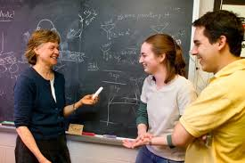
Why do Professors Want Students To Volunteer in their Research?
To train students who can be invested in their research in the long term
To get support on studies in a challenged funding environment
To learn and get new perspectives on their research ideas
To get collaborators for graduate student researchers

Slide 13
Who should be applying to research volunteer positions?
Students with a B+ GPA or higher
Students who can dedicate 5-10 a week for a year
Students who want to grow with a lab (volunteer to RA to thesis to gap year!)
Students who can multi-task AND time manage
Students who are interested in research

Slide 14
Who do professors want to hire in these positions?
Independent, mature, organized, hard working, intelligent students who have skills needed in the lab and will benefit from the experience

Slide 15
WHEN
For Summer term/Fall term but apply early
At the end of a course you enjoy to approach a professor or a TA
Keeping your eyes peeled to UPSA or Undergraduate Program emails about opportunities

Slide 16
WHERE TO GO?
Developmental Science
Quantitative
Clinical/Clinical Developmental
Rebecca Pillai Riddell (mid-Feb)
Rob Muller
Magdalena Wojtowicz
Jennifer Mills (**PAID**; lab management, proofreading, data entry)
History and Theory
BBCS
Joseph DeSouza
Ingo Fruend
Social and Personality
http://psyc.info.yorku.ca/research/research-opportunities/

Slide 17
Top 5 Things to DO
Ask yourself first: Can I do 5-10 hours a week for a year? GRADES first, research second
Throughly read the website and a few abstracts/online articles of profs you are interested in.
Submit a specific cover letter, unofficial transcripts and resume.
Write a professional email to go along with your attachments. Mention you can send any additional information they would require.
Follow up politely within 3 weeks

Slide 18
Top 5 Things NOT to do
Volunteer in more than 2 labs concurrently
Blanket every prof with a request to do research
Approach professors in person as first point of contact
Overload yourself with volunteer commitments
Allow your grades to slip

Slide 19
Advice from your peeps
Grateful to 10 undergrads in the OUCH lab who offered advice for this talk:
Attend lab meetings
Join a lab early on in your career and stick to a few labs
Have a cover letter that highlights your marketable skills (attention to detail, knowing Excel, Powerpoint, SPSS, R, high grades, particular courses)
Be a respectful, professional worker- impression management (eager, diligent, hard-working, positive, reliable)
Appreciate every opportunity- They are doing you a favour not vice-versa!
Bond with other students in the lab – find out the range of opportunities available
Don’t give up looking!!

Slide 20
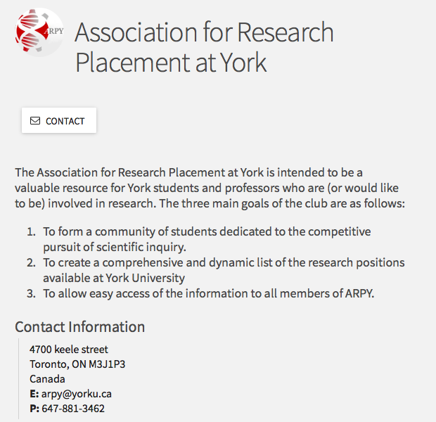
https://yorku.collegiatelink.net/organization/ARPY

