Slide 1


Teaching Not-Knowing:
Cultural Competence and Psychotherapy Training
Priya Watson, MD, MSc, FRCPC

Slide 2
Conflicts of Interest
None to disclose

Slide 3
Objectives
Review constructs of culture and psychotherapy
Describe the “Not-knowing” stance of cultural competence
Translate this stance into concrete changes in psychotherapy training practice

Slide 4

Who’s Here?
Notes:
-immigrate to Canada?
-parents?
-gparents?
-was taught table manners
-was taught how to assess depression
-has a gender identity
-belongs to a profession
-makes eye contact when you say hello to someone

Slide 5
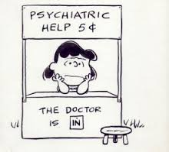
Notes:
Began formally articulating ideas about culture and psychotherapy when invited to present at a Department of Psychiatry’s annual psychotherapy conference, which this year was on psychotherapy supervision
Title of the talk was already determined: “Cultural Aspects of Supervision”. This title created problems for me.
This has to do with my understanding of what culture is. For something to be an aspect of something else, it suggests that it is a smaller part, a component, or characteristic of a separate, larger and more complex phenomenon. The talk title suggests that culture may be a feature of supervision, among other features. Unfortunately for me, since I was the one giving this talk, I see this differently.
I understand culture to be a phenomenon in which all psychotherapy rests, and from which all psychotherapies derive. Further, I understand supervision, as an education practice, to be a cultural practice. Supervision occurs as an embodied set of actions, expectations and beliefs, and as such it IS a culture, and not something with aspects which are cultural and therefore by implication, aspects which are not.

Slide 6
What is Culture?
“the beliefs, customs, arts etc of a particular society, group, place or time”
“an integrated pattern of human knowledge, belief, and behavior that depends upon the capacity for learning and transmitting knowledge to succeeding generations”
-Merriam-Webster Dictionary
Notes:
let’s examine the idea of culture itself.
It’s a word with broad application and diverse usage. We use it colloquially and formally and with it we invoke particular ideas about collective ways of being.
Let’s turn first to the dictionary. The Merriam Webster defines culture as “ the beliefs, customs, arts, etc., of a particular society, group, place, or time”.
Of relevance to thinking about supervision, it also defines culture as ∑ “an integrated pattern of human knowledge, belief, and behavior that depends upon the capacity for learning and transmitting knowledge to succeeding generations”.
So far, so good. Culture is how we think, how we behave and we transmit it as a pattern to those who come after us.

Slide 7
What is Culture?
Content → set of characteristics
  “what”
Process → dynamic interactions
  “how”

Slide 8
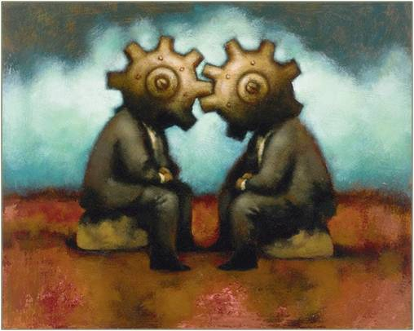
Kirmayer
Culture “involves a flexible, ongoing process of transmitting and using knowledge that depends on dynamics both within communities and at the interface between ethnocultural communities and institutions of
the larger society, like the
health care system, as well
as global networks”
Notes:
Laurence Kirmayer is anthropologist and cultural psychiatrist based at McGill U in Montreal – very influential thinker in the field.
Here is his definition of culture.
It’s interesting to see how his perspective is similar to that last Merriam-Webster one – see language around transmission. The word process is even in there – you can see how he takes much more of a process approach. (2) More of a “how” culture manifests, than a more static “what” description of culture.
Just to situate ourselves: We use this kind of approach to culture.

Slide 9
One way to know the culture
is to transgress it.
-Howard Garfinkel
Notes:
Howard Garfinkel, a sociologist and ethnomethodologist stated that “One way to know the culture is to transgress it.”
Here the idea is that by consciously or inadvertently transgressing cultural norms we discover what they are.
I find this to be a useful construct in considering breaches in either the therapeutic or the supervisor-trainee alliance. What if we were to understand these breaches as cultural breaches? In other words, not the disruption of understanding and alliance between two individuals alone, but divides that arise between two cultural models, systems of meaning, ways of being human.
At these breaches, or points of intersection and transgression, we discover the practices and expectations of therapist, client and in fact of the supervisor.

Slide 10
What are the cultures in play?
Therapist-Patient
Supervisor-Patient
Supervisor-Discipline
Therapist-Supervisor
Discipline-Society
Notes:
When we talk about culture, psychotherapy and supervision, there are many frameworks for approaching this discussion. Which interplay of cultures are we examining?
∑That between therapist and patient? Between therapist and supervisor? Between supervisor and patient? Between supervisor the discipline in which they teach? Between the discipline and the society in which it functions?
At first glance, we’ve identified five distinct cultures, all at play, all intersecting and co-creating the therapeutic and educational experiences. In fact, these five no doubt represent a gross oversimplification of the cultural categories in play.
There are certainly sub-cultures within cultures interacting.
So many different cultural models are present in the room, in the encounter, and many selves interact when therapist, client and supervisor engage with one another. This complexity has prompted a great deal of writing on the subject, and a number of theoretical frameworks for understanding this complex eco system.

Slide 11
Cultural Competence
Content-Oriented
Information acquired by expert
Process-Oriented
“how clinicians ascribe meaning and integrate such meaning in the clinical encounter rather than what therapists know about specific groups.”
-Lakes, Garro
Notes:
One such framework which gained prominence in health care literature is the notion of cultural competence. Cultural competence is broadly understood to be the ability to work effectively across cultures, coming from an awareness of one’s own cultural perspectives and those of our patients. There have been two main schools of thought regarding cultural competence – one with a content, or information emphasis, and one with a process emphasis.
In the first, content-oriented model, competence is seen to be achieved by a clinician who acquaints herself with the cultural norms of whichever national or ethnic sub-group her patient claims. I
n this model, information is power – a therapist will deliver skillful and appropriate therapeutic interventions because she will understand the particular beliefs and conventions of her patient’s culture of origin. Sometimes, a system will attempt to be culturally competent by providing like-ethnic therapists for individuals, presupposing a greater cultural affinity and therefore competence. This approach has several significant problems. It is reductionistic – it presumes that ethnicity, or language, or country of origin are stand-ins for culture, when the anthropological literature has told us otherwise for decades. It is in some ways essentializing, assuming fewer within-group differences than likely exist, and ascribing to individuals traits or perspectives based on assumptions about their ethnic identity.
In my experience trying to encourage trainees to engage in psychotherapy with patients with whom they do not share a language or a culture, I have found that this content-oriented notion of competence presents a real disincentive for learners. If they feel they need to understand a whole culture before they can understand their patient, then they may opt out entirely. This was borne out by a study done in 2004 at the University of Toronto. This survey of psychiatry residents showed that 85% of respondents did not consider cultural factors in psychotherapy, and 75% avoided psychotherapy in preference of pharmacotherapy with minority patients.
This study was done 9 years ago, and we have since developed comprehensive and process-oriented curriculae on culture and psychiatry, so I hope and believe the numbers today would be much different
∑ Lakes and Garro have described process-oriented models as those that focus on how “clinicians ascribe meaning and integrate such meaning in the clinical encounter rather than what therapists know about specific groups”.

Slide 12
Explanatory Models
A process to elicit understanding within the patient’s own cultural references
Notes:
process-oriented approach was championed by Arthur Kleinman, a professor of medical anthropology at Harvard University who has been hugely influential in our thinking about culture and health care. Kleinman’s framework of ‘explanatory models’ provided a process by which a therapist could elicit a richer understanding of how the illness or suffering was being understood and experienced within the patient’s own cultural references. This was a more-skills based approach, relying less upon knowledge, or a vague specifier of ‘openness’, and actually encouraging an active engagement between care provider and patient, emphasizing the negotiation of meaning through a shared process.

Slide 13

Reflection and Uncertainty
Notes:
if we accept psychotherapy as a cultural practice, do we then accept that there may be human problems and types of suffering which require different cultural interventions altogether? In our interest in enhancing reflective capacity in our trainees, do we allow for the most fundamental uncertainty of all, the question of whether this particular cultural practice, psychotherapy, is appropriate for the particular human suffering before us?
This fundamental uncertainty and humility is different from ways in which we often discuss psychotherapy with trainees. We may ask our trainee if the client is appropriate for psychotherapy. In doing so, we may perpetuate an individualistic cultural orientation of the self. We may inquire about the client’s readiness, their commitment level, their psychological-mindedness.
In other words, when we speak to our trainees about how to assess for suitability for psychotherapy, we talk about the patient. We do not tend to talk about psychotherapy itself; the ways in which it is a practice derived from Euro-American Judeo-Christian individualistic societies rooted in particular constructs of the self.

Slide 14
The Self
“the Western conception of the person as a bounded, unique…dynamic center of awareness, emotion, judgment and action organized into a distinctive whole...is, however incorrigible it may seem to us, a rather peculiar idea within the context of the world’s cultures.”
-Clifford Geertz
Notes:
Clifford Geertz, the highly influential American cultural anthropologist, wrote”.
Do we invite our trainees to contemplate this peculiarity when we teach them how to assess for what we call suitability for psychotherapy? When psychotherapy doesn’t work, do we reflect on whether this was because it was a mismatch of cultures, or do we perpetuate a cultural blindspot, by locating the problem within the individual client, and encouraging our trainees to do the same?
In the highly pluralistic society in which we live today, how do we prepare a trainee psychotherapist who may encounter a patient with a conception of the self that is collectivist, or socio centric or even cosmo centric? Where the self is not bounded or unique, but inextricably linked through relationships with either family, the natural world, or the world of spirit? Can we expand our reflective practices, our tolerance of uncertainty, to include the core uncertainty that psychotherapy itself is a practice that may not fit the suffering?
To over-simplify with an analogy, we do not assume that the way we prepare food and consume it is the same across cultures. We recognize that food preparation and rituals of food sharing are cultural constructs, and we’re unlikely, in the age of liberal pluralism, to suggest that one way of preparing and sharing food is appropriate to every person and every hunger.

Slide 15
I’m Nobody’s Child Now
Notes:
I have a story about this. I remember a woman I treated when I was training in psychiatry. She was of Asian heritage, and had lived in Canada for over 30 years. When her father, who still lived in Asia, died, she became depressed. She was referred by her family physician for treatment of this depression and I met with her and tried to help.
In our first meeting, she cried throughout, and this 50 year old woman repeatedly told me she was “Nobody’s child now.” Where she grew up, identity was conferred through the relationship to the father – the most common question people would ask each other when getting to know one another was “Who’s your father?” This question served to locate each person in a complex web of relationship that organized the social system and conferred identity and connection. After the death of her father, though her mother was still alive, this woman felt effectively orphaned.
I spent time gamely trying to understand the particulars of her relationship with her father, the course of her depression, and the coping strategies she was using. My supervisor encouraged me in this. Her depression did eventually remit, when she connected with a paternal uncle. She travelled back to India, and spent time with her family there, and this uncle came to represent for her a continuity of the presence of her father. She was once more in the web that had sustained her. This was the real healing intervention.

Slide 16

Divergence, Instability and the
Push for Resolution
Notes:
The Working with Culture curriculum at McGill University emphasizes the idea of ‘divergences’ and a need for tolerating very high levels of uncertainty. Rather than the reassuring process of working towards a convergence of meaning, they describe the transcultural clinical spaces as containing a mulitiplicity of voices which “are a constant source of critique or disequilibrium rather than resolution”. This tension, and disequilibrium, can be very difficult for both learners and supervisors to tolerate, and there can be a reactive push for resolution. The role of the supervisor then is to promote tolerance of this uncertainty, even to the extent of questioning psychotherapy itself. Learners are vulnerable to the idea that they should know, or find a way to know, and finally to arrive at certainty and coherence in the story of their knowing.
This push for coherence can also come from the way psychotherapy supervision usually takes place, where the learner must present a retrospective narrative of the session for their supervisor to digest and evaluate. Simply the act of trying to craft such a narrative can put pressure on the ambiguities, dissonances and uncertainties of the experience, flattening them out into a false homogeneity that suggests no major gaps in understanding . Similarly, as the supervision draws to a close, either because of some external artefact such as the end of a trainee’s rotation, or the approach of some previously determined total number of sessions, there is pressure on the trainee, and perhaps the supervisor as well, to have a narrative with closure.
When multiple levels of meaning, and multiple forms of cultural enactment are taking place, attunement between therapist and patient can be a shifting sands. Forcing a sense of stability and coherence on these shifting sands can certainly allow for reduction in uncertainty, and perhaps anxiety. But we miss a central opportunity that working across cultures provides: the opportunity to work in not knowing, to show learners that not knowing and tolerance of the tension that not knowing creates, allows for multiple levels of meaning, story and practice to emerge. When we treat psychotherapy as one culture’s practice, rather than simply as a way of being with another, then we can examine the influences of place, time, power, and convention in shaping this cultural practice. It also frees us to look past ideas of competence, or suitability of either patient or therapist, to deep questions of social and interpersonal realities, and to be open to the possibility that healing is located in some entirely other cultural ritual.

Slide 17
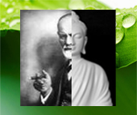
Same/Other
Notes:
This work contains a central tension, between sameness and otherness, between that which can be understood and that which may be too far outside the frame of reference of the Western discipline of psychotherapy to be comprehended within it. The true otherness, or ‘alterity’ of a patient and her suffering poses an existential challenge to the uses of psychotherapy. If culture defines the self, and modes of healing, then we must acknowledge that those concepts vary widely, and our own ability to address this variation within the psychotherapeutic framework may be more limited than we acknowledge to ourselves.
It is striking how little we teach about the cultural roots of our therapies. In eliding this history, we are enacting form of hidden curriculum with our learners. The hidden curriculum, which is a concept that comes from the education literature, is that which is enacted and embodied by teachers, and absorbed by learners, without being made explicit. Examples from the hidden curriculum literature in mental health care include such notions as ‘professionalism’, or inter-disciplinary relations such as those between psychiatrists and psychologists, or questions of ethics. Supervisors, in their way of doing their work, teach learners about these issues without making them explicit. Very few of us received direct instruction or discussion of such issues as how to dress, for example, or how to work with other health professional colleagues, or how close to sit to our patients when we’re speaking together. These things were demonstrated for us, over and over, without much overt discussion. This way of teaching creates a sense that this is just the way it is, it’s a form of truth in motion. This is the way things are done, this is how we act, this is how we think. In other words, this is our culture. Just as a child learns her culture by living it, so do learners acquire the culture of psychotherapy.
By keeping the cultural and historical grounding of psychotherapy ‘hidden’ – meaning enacted without being analysed or critiqued, we convey a sense that this is just the way it is done.

Slide 18

Hidden, Invisible, Unexamined
Notes:
How do we move away then from hidden curriculae, invisible identities, unexamined expectations?
How do we enact and teach culturally competent psychotherapeutic practice?

Slide 19
Cultural Competence
“how clinicians ascribe meaning and integrate such meaning in the clinical encounter rather than what therapists know about specific groups”
Lakes and Garro
Notes:
Cultural Competence has been the framework via which these issues are addressed.
Through this framework, we hope, the invisible gets addressed, and the role of culture in experiencing and also healing mental anguish can be understood.
This is arguably just good therapeutic care. Nothing special there for ‘cultural groups’. However, role of structural, systemic inequities also have a special place in culturally competent care.

Slide 20
Cultural Competence
Recognition of cultural diversity coupled with analysis of the structural sources of inequality offers us the best way to understand and redress the inequities and injustices that are ignored, or even aggravated, by culturally-blind health care
Fraser & Honneth, 2003
Notes:
This warrants emphasis, because of issues of “otherness” and power.
No matter how much you think of these as generalizable skills – and they are – the fact is that because of societal disparities, there are some groups where the stakes of attending to these issues are higher. Those higher stakes are reflected in the disparities that we see in population health indicators. Which are worse along lines of class, sexuality, race, and so on.

Slide 21
Cultural Intersections
Patient
Supervisor
Discipline
Trainee
Society
Notes:
So cultural competence focuses on the interactions, transgressions and confusions of these points of intersection, paying special attention to structural inequities and untested assumptions.

Slide 22
Cultural Competence
Process not Content
Iterative, Evolving, Flexible
The “How” of Cultural Competence:
  The “Not Knowing” stance

Slide 23
The Not-Knowing Stance of Cultural Competence
Reflection
  meta-cognition
  modeling
Humility
  critique of the practice itself
Mutual Recognition
  inescapable “otherness”
Mutual
Recognition
Humility
Reflection
Notes:
-literatures: medical education, psychotherapy evaluation, cultural competence
-engaging in each of these strategies is essential to the whole
-each strategy promotes the others, they are additive as well as interactive

Slide 24
Reflection
Meta-cognition
Schon: Reflecting In and On Action
Themes in the Reflection literature
  Flexibility
  Mindfulness
  Modeling
  Iteration
  Link to doing
Notes:
Reflection is iterative – it’s engaged in, tested through experience, and then re-engaged both during the experience and then later at some distance from the experience.

Slide 25
Reflection
Involves cultivating habits of mind such as experiencing information as novel, thinking of “facts” as conditional, seeing situations from multiple perspectives, suspending categorization and judgment, and engaging in self-questioning
Epstein 2008
Notes:
See the same interplay of analytic thought, suspension of pre-conceptions, flexibility and humility that make up the not-knowing stance.

Slide 26
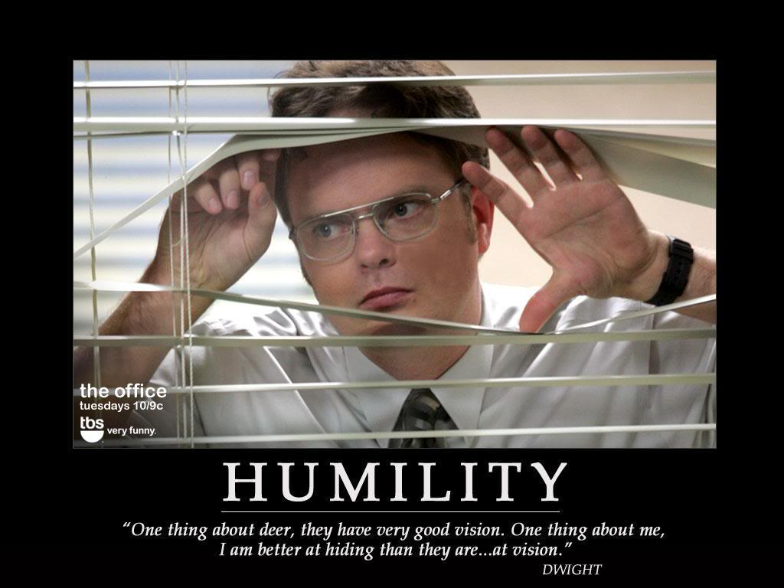
Holding your position lightly
Allowing for fundamental uncertainty
Notes:
Holding lightly = Being able to examine your position and the other’s position. Seeing multiple positions as valid and being more flexibly able to release assumptions quickly.
Fundamental uncertainty = questioning the practice itself. Not just the other, the client, that is uncertain, but also the very use of psychotherapy in the first place.
Humility about the appropriateness of the enterprise you’re undertaking.

Slide 27
Humility
Self-reflexivity that foregrounds issues of power and legitimacy
Questioning the Practice itself
Found in literature of Reflective Practice and in literature of Cultural Competence
Notes:
We’ve talked about the centrality of reflection, but humility prompts a certain kind of reflection that is more likely to be culturally competent.
-to be fully reflective, to model embracing uncertainty and ongoing parallel process of humble self-examination supervisors must rigorously scrutinize the fact of psychotherapy being itself a cultural practice, deriving from a particular social perspective, and re-ifying particular values. Psychotherapy as we teach it derives from an individualistic, judeo-christian european tradition and world view. Even those psychotherapies which originate from eastern contemplative traditions like mindfulness or dbt, do not include in their training manuals an encouragement for supervisors to explore and unpack with trainees the interactions of the psychotherapies' cultural traits with those of the patient.
-we found this concept in two separate literatures – education literature on reflective practice, and the literature on cultural competence which is more theoretical and critical of social inequities

Slide 28
Reflective Practice and Humility
The goal of reflection is cultivating habits of mind that allow for informed flexibility, ongoing learning and humility
                Wald 2009

Slide 29
Cultural Humility
Cultural humility is…a willingness and ability to listen and learn from patients, but without shying away from the way in which culture and difference are used to stereotype and oppress people or divert attention from various forms of structural violence
                Kirmayer 2012
Notes:
by explicitly foregrounding the culture of the practice of psychotherapy itself, and the expectations it has around world view and identity, we are also able to foreground issues of power. By taking a systems perspective, where psychotherapy is located as being part of greater socio-political dynamics, we can follow Kirmayer's guidance not to shy away from these realities
Structural violence: the ways people can suffer within social systems
Not shying away = actively eliciting, tolerating disequilibrium, discomfort and uncertainty, are what allow for Mutual Recognition.

Slide 30
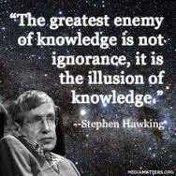
Mutual Recognition

Slide 31
Mutual Recognition
Inescapable “otherness” of the encounter with a client
Exploring the unknown
Acknowledging the unknowable
Convergence/Resolution
          vs.
Divergence/Disequilibrium
Notes:
Mutual recognition does not mean everything is known. Rather, the unknown is collaboratively explored, and the unknowable is acknowledged.
the goal is to protect space for a multiplicity of voices that are a "constant source of critique and disequilibrium". The patient is inescapably "other" and there are unknowables to be acknowledged WITH THE PATIENT
WITH THE SUPERVISOR: tolerating disequilibrium and uncertainty, resisting that reactive push for resolution, fostering ‘not knowing’ to allow for multiple levels of meaning, story and practice to emerge.

Slide 32
The Not-Knowing Stance of Cultural Competence
Reflection
  meta-cognition
  modeling
Humility
  critique of the practice itself
Mutual Recognition
  inescapable “otherness”
Mutual
Recognition
Humility
Reflection
Notes:
-Review this
-Review specific strategies within supervision

Slide 33
Psychotherapy Supervision
For supervisors and trainees, how did you (or how could you):
Name and explore your ignorance and hypotheses? [Reflection, Mutual Recognition]
Discuss the cultural limits of the psychotherapy paradigms being taught? [Humility, Reflection]
Explore the presence of the unknowable aspects of the “other” for both trainee and client? Talk about otherness and power? [Mutual Recognition, Humility]
Protect and promote uncertainty? [Reflection, Humility, Mutual Recognition]

Slide 34
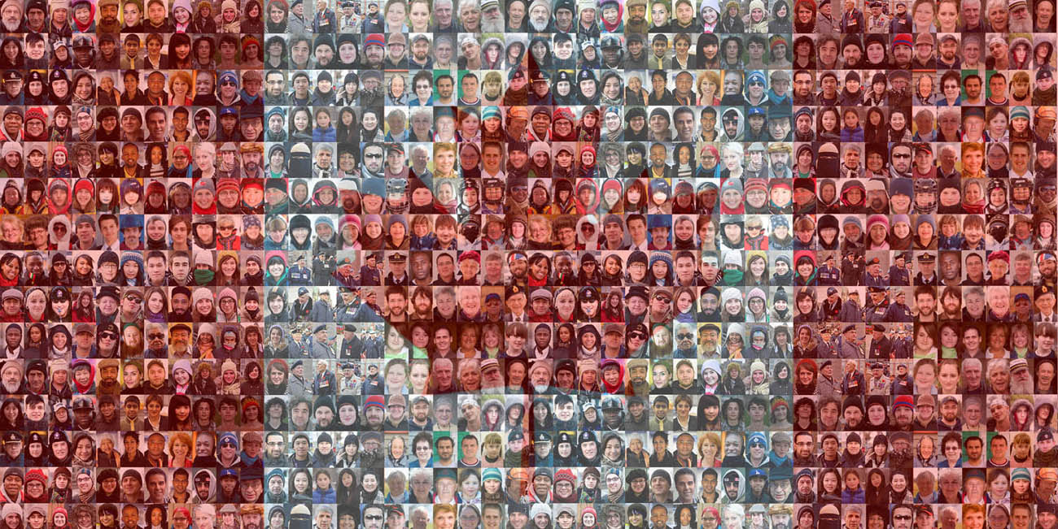
Many Selves
Notes:
We’ve talked a lot about theories today. But we all know these are the embodied realities we each live every day.
For more than the past 100 years, one in five Canadians was born outside of Canada. In Toronto, half of our population is born outside of Canada. As a supervisor and a psychotherapist, I think my background and experience are typical of the myriad cultural forces at play. I am an immigrant to Canada, arriving here as a baby. My mother is from an upper caste Hindu family from New Delhi, and my father is a white Queenslander from a Protestant family where most did not complete schooling past grade 8. I grew up in Canada, India and the United States.
I recently supervised a resident who comes from Romania. One of our psychotherapy cases was a teenaged boy with a mother from Jamaica and a father from Sierra Leone. This young man was referred for assessment of psychotic symptoms. I was reminded of the literature showing that a disproportionate number of African American males are diagnosed with psychotic disorders, when we determined that this young man was in fact so anxious that he talked to himself because he was trying to soothe himself, not because he was responding to hallucinations.
These three people, the resident, this boy, and I, with all of our cultures, our selves, are joined together in a project of healing. It is uncertain and complex. We are engaged in a cultural practice that does not neatly map onto our own cultural inheritances, and we must find ways to explore the dissonances, ambiguities and limits of this practice, in order to make choices that will promote healing and learning for all involved.

