Slide 1
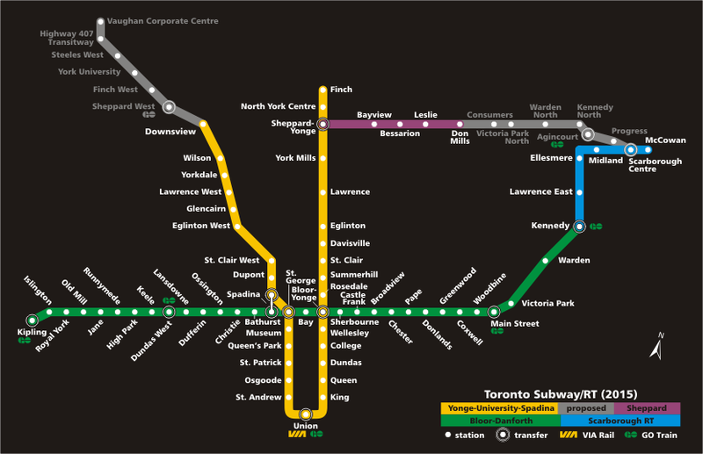
Graduate Studies in the Clinical Developmental Area: En Route to Success
Dr. Maggie Toplak, C. Psych.

Slide 2
Areas that we excel at….
Relationships and social development
Developmental cognitive neuroscience
Child clinical populations
Treatment approaches and outcomes
Professional function related to child development

Slide 3
Introducing…
The CD area
navigator coaches

Slide 4
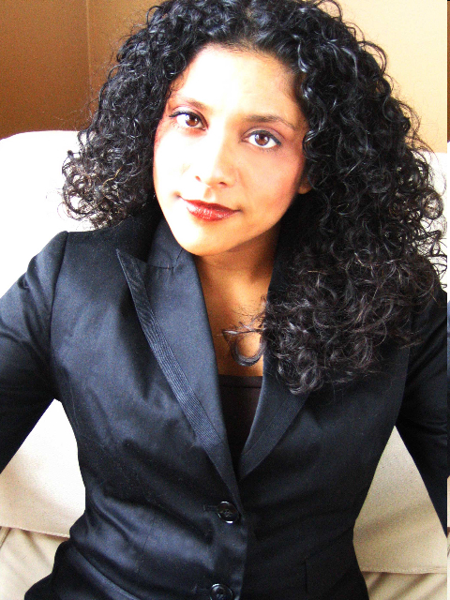
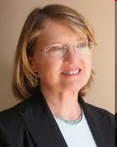
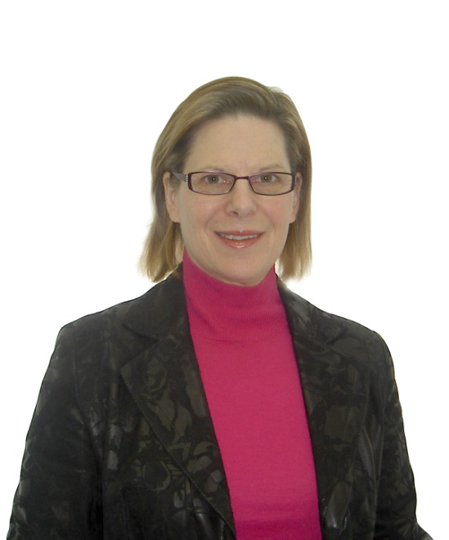
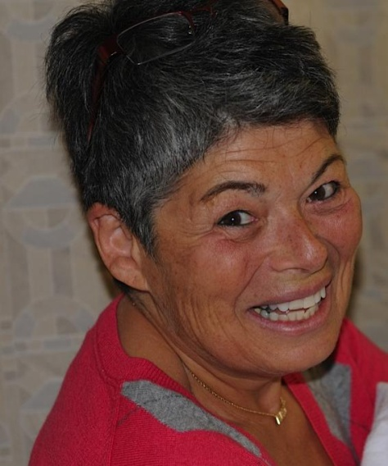
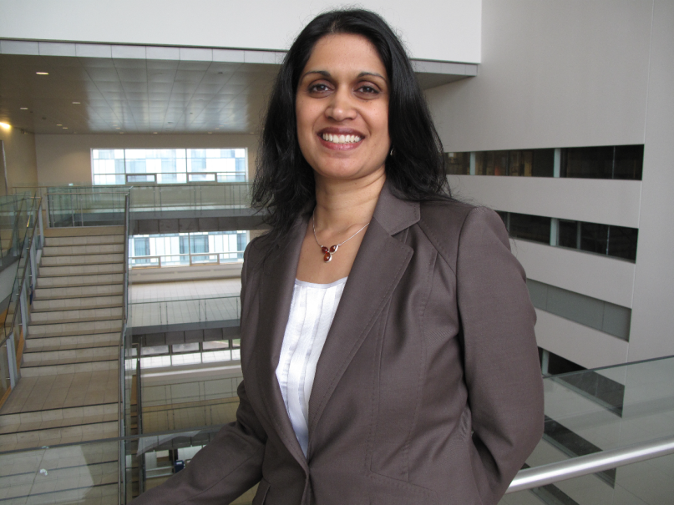
Relationships &
Social Development
Rebecca Pillai Riddell
Debra Pepler
Jennifer Connolly
Maxine Wintre
Jennine Rawana

Slide 5
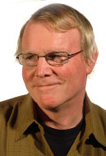
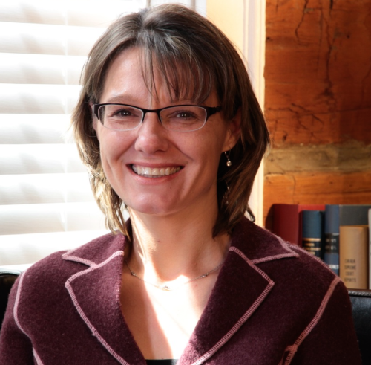
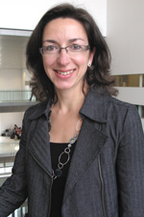
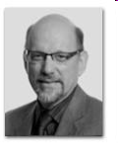
Child Clinical Populations &
Developmental Cognitive Science
Mary Desrocher
Maggie Toplak
Tim Moore
Jim Bebko
Christine Till

Slide 6
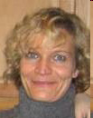
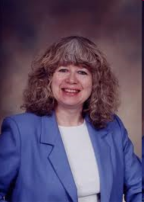
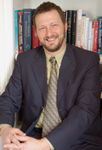
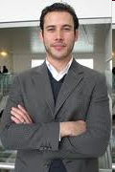
Treatment Approaches & Therapy Outcomes
Jonathan
Weiss
Yvonne Bohr
Adrienne Perry
Robert Muller

Slide 7
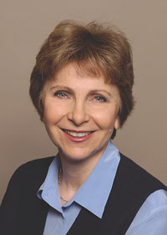
York University Psychology Training Clinic (YUPC)
Dr. Louise Hartley, Clinic Director
Integration of YUPC into CD Training Program from MA to PhD

Slide 8
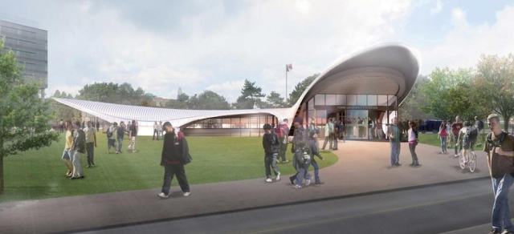
We are committed to student training – getting your destination!
Notes:
Faculty members serve on various clinical training committees

Slide 9
Our training program is structured to deliver results
The Clinical Developmental Handbook
2015-2016
Department of Psychology
York University
Notes:
Only 153 pages!!

Slide 10
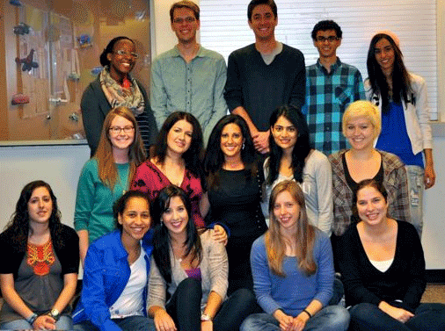
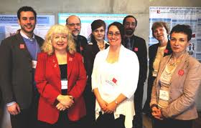
Training Opportunities Beyond Your Lab are Encouraged!
CD area program is designed to give breadth in training to enhance student experience
Committee Membership
Minor Area Paper
Research Centers
Autism Research Alliance
Members of the LaMarsh Centre

Slide 11
Our teams are represented at all levels
Our faculty and students participate in international, national, and local conferences
APA, CPA, APS, SRCD, SRA, INS, etc.
SickKids, CAMH, PrevNET, LaMarsh, etc.

Slide 12
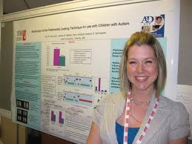
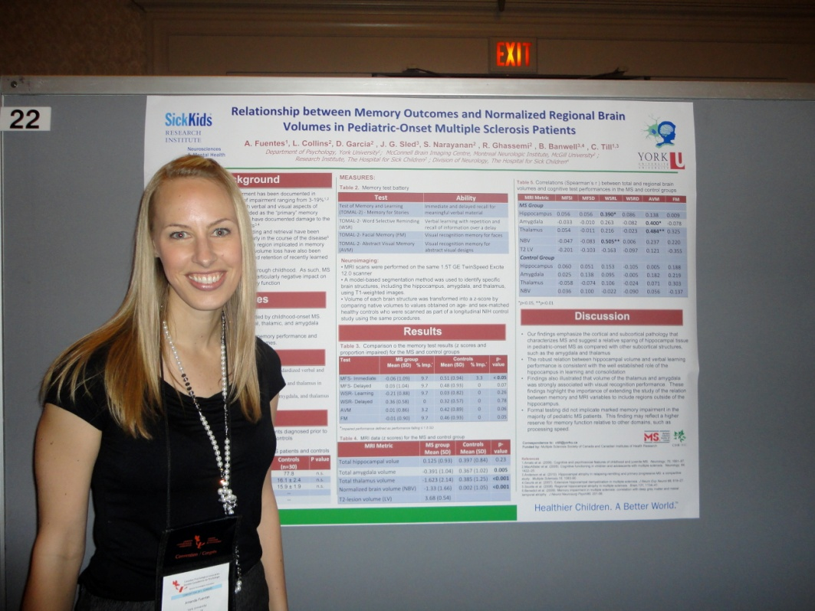
CD area students presenting at conferences

Slide 13
Grants and Scholarships
Faculty members hold grants from all three federal granting councils and a wide variety of provincial and private granting agencies
Many CD area students hold external scholarships
SSHRC, CIHR, NSERC, OGS, CHEO, OMHF

Slide 14
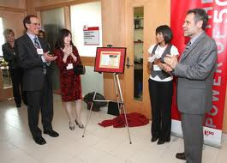
Internal funding support for our students so they can focus on training!
York university guarantees financial support for our graduate students through competitive funding packages (TAships, graduate assistantships, etc.)
PLUS internal awards through the Faculty of Health are also awarded each year.

Slide 15
Integrating Science & Clinical Practice
Faculty members integrate clinical work through research
Adjunct affiliations with local hospitals and community mental health agencies

Slide 16
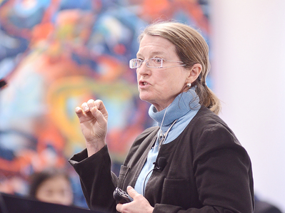
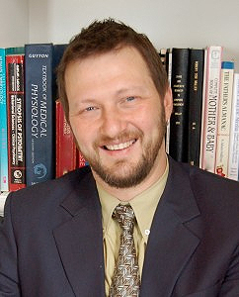
Knowledge translation of research is highly valued
Relationships are key.
Our magazine provides accurate information on mental health to help break down the barriers of stigma those with a mental illness often face.
Dr. Debra Pepler addresses educators at a bullying seminar hosted by York University at the Markham Convergence Centre
Dr. Robert Muller, founder of the Trauma & Mental Health Report

Slide 17
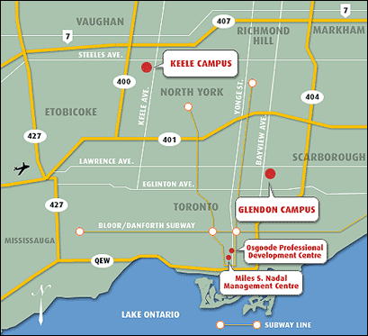
Diverse Clinical Practicum Placements available for our students in the GTA
A wide range of clinical practicum placements.
Geography is an advantage!
Southlake Hospital
CAMH
North York General Hospital
Integra Foundation
Lakeridge Health
Kinark
SickKids
Thistletown
ROCK
Aisling Discoveries

Slide 18
CD students are very competitive in the APPIC internship match
In the past 3 years, we have had an extremely high APPIC internship match rate (ranging from 90% to 100%) when national rates have been in the 75% range!

Slide 19
Impressive resources available for our trainees
Access to clinical equipment
Psychology Resource Centre
State-of-the-art technology
Hebb Computer lab
Statistical support

Slide 20
Additional Training Opportunities
Clinical Neuropsychology Stream
Health Psychology Graduate Diploma
AND
Neuroscience Graduate Diploma
Quantitative Methods Diploma in Psychology

Slide 21
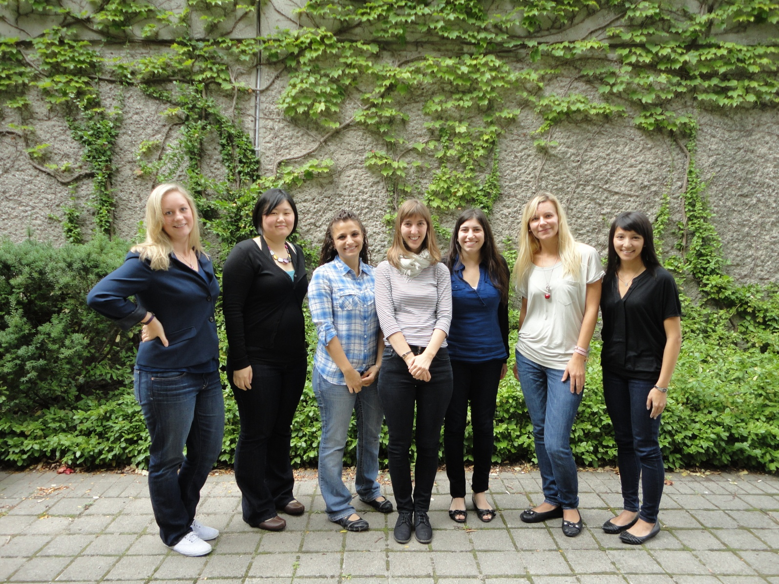
Cohesive and optimal size MA cohorts
Males are part of each cohort too!

Slide 22
The Clinical-Developmental Area is a Community Within the Larger Psychology Graduate Program
CD area

Slide 23
Students have an active role in decision-making
Annual Town Hall meeting to discuss the CD program with students
Student Advisory for YUPC

Slide 24
Team building is valued
At least 2 social events per year with graduate students and faculty members

Slide 25
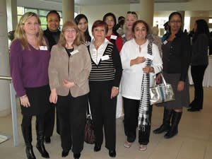
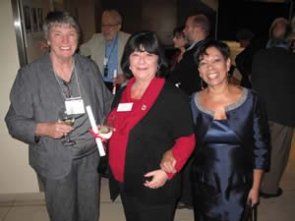
Dedicated administrative support at York for students and faculty

Slide 26
Colleagues from the Clinical area and the department at large!

Slide 27
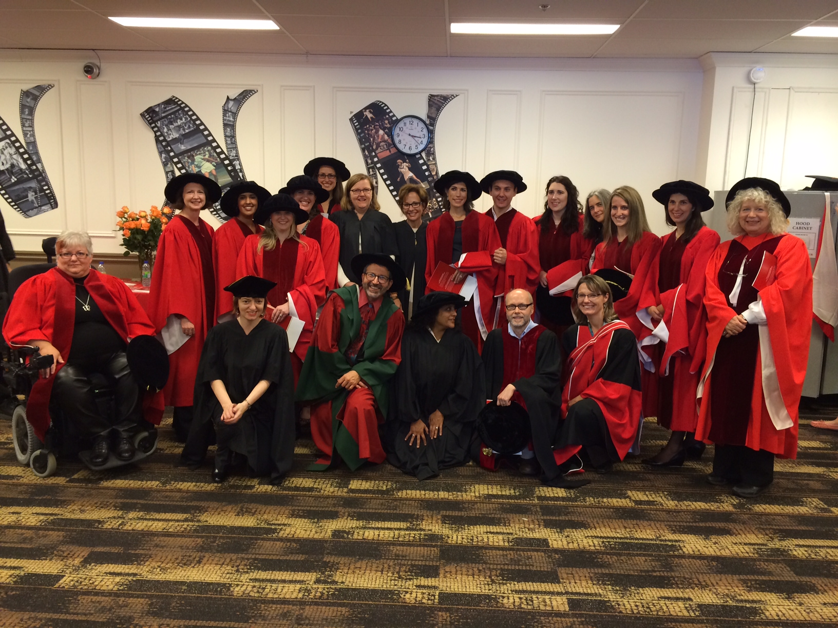
We want to help you meet your training goals – to get to your destination!

Slide 28
NEXT
Q & A session with current CD area students
Meetings with faculty supervisors
YUPC tours
Offered every 30 min between 2:15-5 pm
Meeting: BSB Stairwell, 1st Floor

