Slide 1
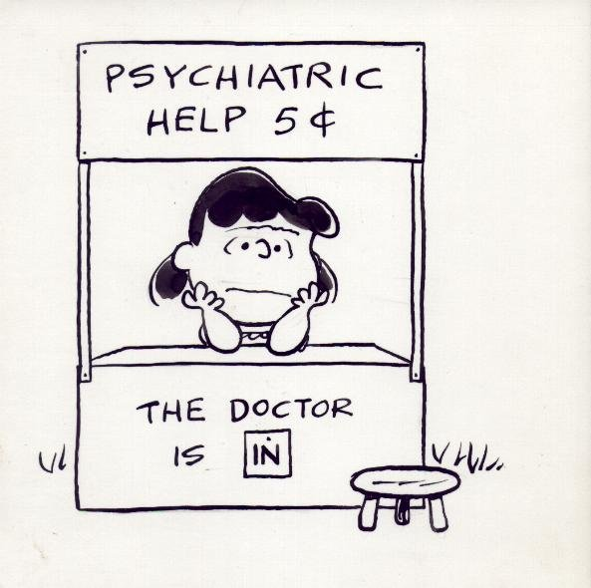
Becoming a Clinical Psychologist at York University
Henny Westra, PhD, C.Psych
Clinical Psychology Open House
February 14, 2014
Notes:
Explain idea behind the theme…

Slide 2
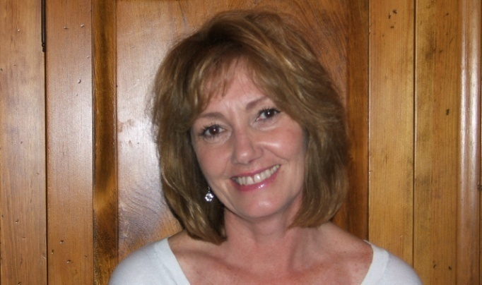
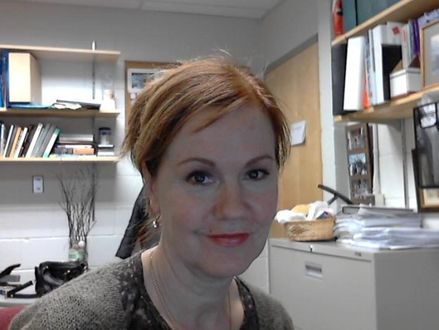
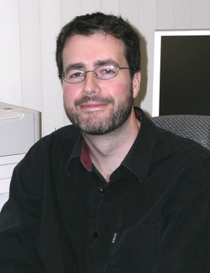
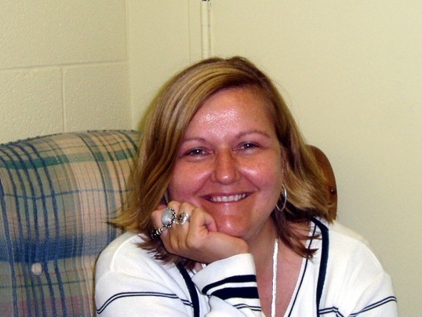
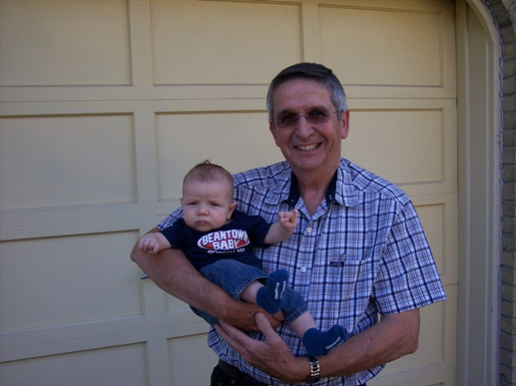
Lynne Angus
Psychotherapy Research
Alberta Pos
John Eastwood
Henny Westra
David Reid
Notes:
Lynne: Understanding and facilitating the relationship between a client’s personal story telling and emotional expression in psychotherapy. Another more technical term for narrative is client disclosure of autobiographical memory. Understanding the contributions of narrative and emotion processes for enhanced therapeutic engagement and treatment outcomes.
Alberta: Student of Les Greenberg. Most passionate about validating both experiential factors such as therapist empathy, to outcome in psychotherapy. How does this related to the client’s alliance with the therapist, and ability to self-disclose? How does the combination lead to outcome?
Henny: My current research is examining and evaluating the integration of MI into CBT for anxiety and related disorders. Psychotherapy process research, esp resistance/engagement in therapy, as well as client outcome expectations are also key foci.
David Reid: Grad student are looking at small group workshops for couples. Extension of research program on psychotherapy for couples. Over one month, these workshops make a difference. The techniques used are derived from our previous research on distressed couples.
John: The overarching objective of John's research is to understand the relationship between emotion and attention. Clinical context: looking at how client’s emotional state changes, moment by moment, over the course of therapy sessions. How emotional processes are related to attentional processes.
He is also particularly interested in boredom (could never figure out why) and determining the characteristics of boredom prone people!
Recently looking at the effects of screen time (excessive time spent watching movies, playing computer games) has on our attention system and ability to regulate emotions.

Slide 3
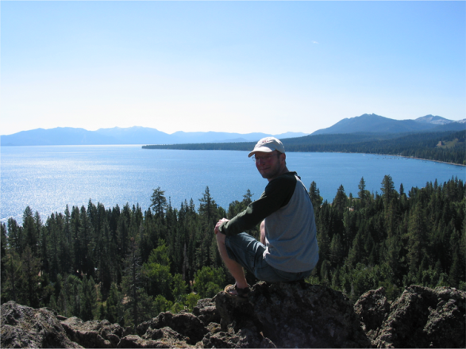
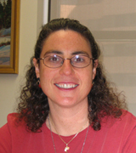
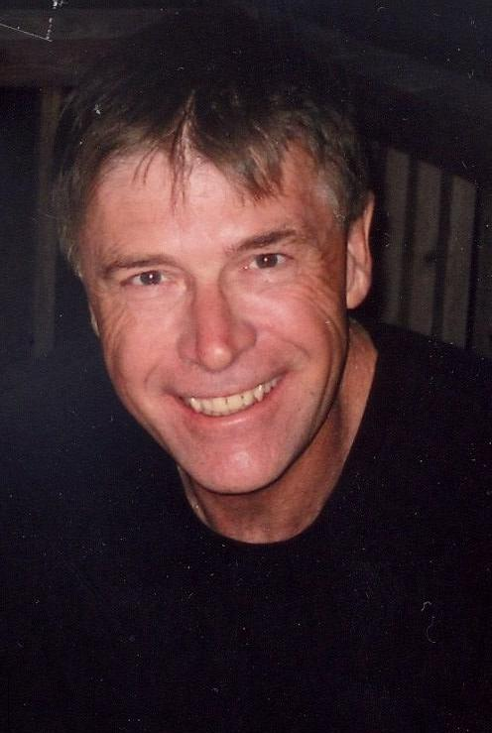
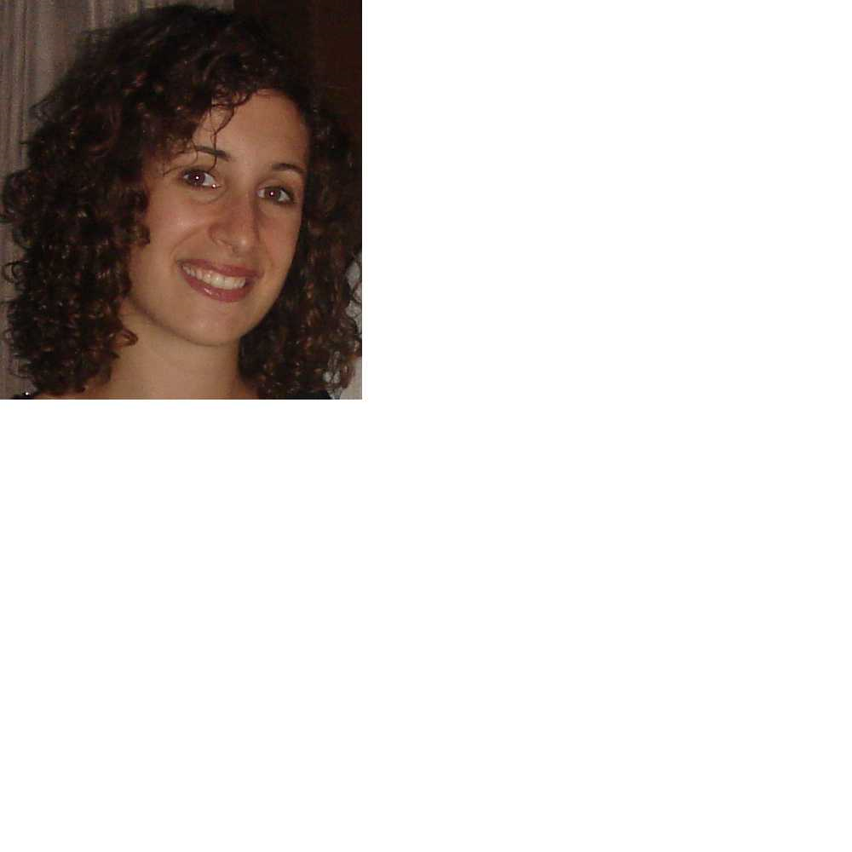
Neuropsychology, Memory and Cognition
Jill Rich
Gary Turner
Norm Park
Shayna Rosenbaum
Notes:
Jill: I'm looking at the potential cognitive effects of chemotherapy in breast cancer patients. A subset of cancer patients who take chemotherapy (roughly 30%) complain of trouble concentrating, multitasking, remembering things, and generally, seem to have "brain fatigue," where they get mentally tired more easily than before their therapy. it is sometimes called chemobrain or chemofog. We are studying this phenomenon systematically before and after chemo to see if it is the result of surgery, the chemo, the cancer itself, disrupted sleep, anxiety, or other factors.
Gary:
Looks at how cognition is implemented in the brain! He uses functional neuroimaging and experimental neuropsychological methods to understand this. More importantly, this research translates into interventions designed to remediate cognitive deficits in aging and brain disease.
Shayna: I study the neural basis of impaired memory for past personal events, as an example in
1) amnesic patients with damage to the hippocampus due to a variety of etiologies, including anoxia (loss of oxygen to the brain), encephalitis, severe traumatic brain injury, and Alzheimer's disease,
2) patients with damage to prefrontal cortex due to stroke/aneurysm, tumour resection, head injury, frontotemporal dementia, etc., and
3) healthy older adults, as the hippocampus and prefrontal cortex are known to change both structurally and functionally with age.
Is able to identify the function of various brain structures, e.g. patients with hippocampal damage are not only unable to remember past events but are also unable to imagine future events.
Looks at techniques to help remediate areas of memory impairment, in neurological patients.
Norm: My research currently is examining whether individuals with Parkinson's disease can acquire motor procedural skills, through the use of declarative memory when given sufficient practice. “Use of a tool like a hammer normally requires motor procedural memory whereas recalling the appearance of a hammer or its function requires declarative memory. It has been proposed that reduced motor procedural memory may be compensated for by an increased declarative memory.” More broadly my research examines the relation between motor procedural memory and declarative memory.

Slide 4
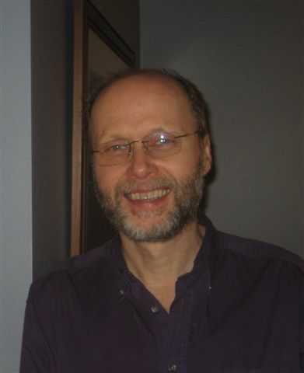
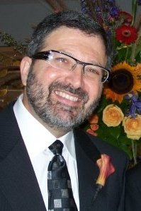
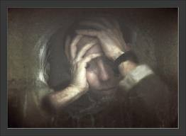
Schizophrenia
Joel Goldberg
Walter Heinrichs
Notes:
Walter: Most people with schizophrenia have cognitive impairments in attention, memory and reasoning along with psychotic symptoms, including delusions and hallucinations. However, a small minority seem free of these impairments yet still experience the same severe psychosis. My lab is studying these exceptional patients and the clues they provide for understanding what is wrong in the brain of schizophrenics.
Joel: A key barrier to getting help for mental health problems has been stigma, including self-stigma. We feel embarrassed and ashamed when we have been diagnosed with a mental illness. Joel Goldberg research group has been exploring ways of reducing stigma and self-stigma. What they found is that actual contact with someone who has mental illness, giving people a chance to hear their story – that makes a big difference in reducing social distance and shame, and might allow people to seek help. His team has delivered presentations to high schoolers about mental health; they talk about celebrities who have a mental illness. But what he has found is that when students listen to a person with schizophrenia tell their story of overcoming auditory hallucinations and delusions, they become much more open and receptive… less judgmental and biased, and more likely to seek help for themselves!

Slide 5
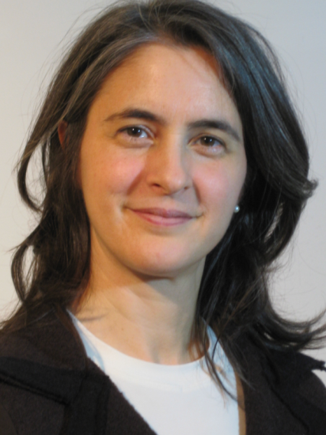
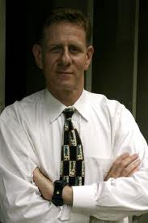
Staying Healthy and Pain-Free
Karen Fergus
Joel Katz
Notes:
Karen: Functioning in couples and increasing the resilience of couples especially when they face a tragedy such as breast cancer. She has developed an online relationship enhancement workshop for couples coping with breast cancer. She also wants to know what happens for the individual after cancer treatment. So what are their struggles in relation to body image, sexual impairment, loss of fertility, and dating and starting new relationships after cancer.
Joel Katz: He is exploring risk/protective factors involved in the transition of acute, time-limited pain to chronic, pathological pain after surgery, accidents, and spinal cord injury. For example, pain catastrophizing before surgery is a risk factor for the development of chronic pain. So the more people, worry, ruminate, and feel helpless in the face of pain before surgery, the more likely they are to develop chronic pain a year or so later. In terms of protective factors, he has discovered that the use of anesthetic – that is, the aggressive management of pain before, during and after surgery may help recovery and reduce the chances of chronic postsurgical pain.

Slide 6
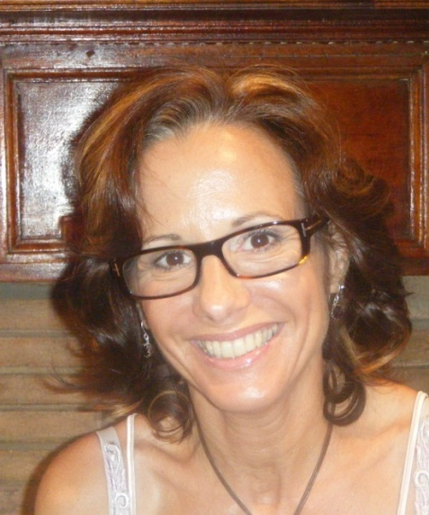
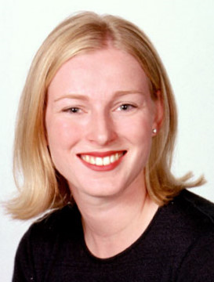
Adding variety…
Myriam Mongrain
Jennifer Mills
Notes:
Jen: The work I am doing right now is on the personality and behavioural variables that influence how accurate someone's body image is. On the whole, everyone thinks they look heavier than usual when they see a picture of themselves. But the more invested we are in our appearance, the more we think we look heavier. The more women "body check" (repeatedly weight and measure themsleves in various weighs), the less likely they are to recognize modifications to their photograph to make them look thinner or fatter than usual.

Slide 7
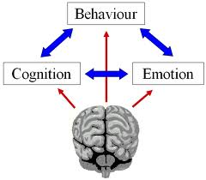
Our Unique Strengths
Students learn a variety of approaches including, CBT, Emotion focused, Motivational Interviewing, Psychodynamic and Constructivist-Systemic approaches -- From the Pros!
We build on strong client-centered foundation including the importance of the therapeutic/working alliance.
We provide careful and thoughtful integration in contrast to just an eclectic approach.
Notes:
All of our 17 core active faculty maintain part-time private practices in their areas of clinical expertise. Professor Westra has developed the anxiety clinic which is involved in training a large number of students in research and practice.

Slide 8
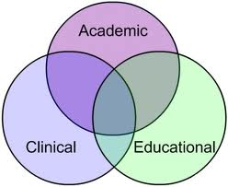
Our Unique Strengths
We offer 2 in-house practica where students are supervised directly and intensively by clinical faculty.
We are rigorous in our process research, an expertise that is rare in the world and for which we are known internationally.
Diversity/Breadth/Collegiality/Innovation/Openness combined with scientific rigor.
Notes:
YUPC: (a) provide progressive, state-of-the art and evidence-based training to graduate students (b) enable empirical investigation of real-world effectiveness and impact of clinical practices for key health and mental health disorders; (c) offer excellent assessment and intervention services to both York University, and the community surrounding York University. It is anticipated that this clinic will significantly enhance the clinical and research training of our students.
Our core faculty are productive researchers who publish in peer-reviewed journals, and a majority hold external research grants. Further all are conducting research in areas related to clinical practice.
In the first year of the MA, students do a research practicum with their supervisors, which provides them with an apprenticeship experience and exposure to clinically relevant research that forms the groundwork for the Master’s thesis.
Finally, students are encouraged to become members of professional societies and to attend national and international research meetings annually. Students are also encouraged to publish their work and they are mentored through writing and submitting peer reviewed publications by collaborating with faculty members in research publications.

Slide 9
What’s Great about Our Program?
Graduate student testimonies:
“We are encouraged to work on ourselves and use ourselves to build the best relationship with clients – based on research showing the best therapeutic outcomes.”
“We have our own clinic where students can gain clinical experience from the very beginning. As we receive high quality supervision.”
“We receive training in a range of therapeutic modalities, and most importantly, an emphasis on learning how to integrate across various modalities.”

Slide 10
What’s Great about Our Program?
Graduate student testimonies:
“We have an opportunity to learn from a very accomplished professors who take the time to get to know you & care about your growth as a clinician.”
“We get training with faculty that are leading researchers in their chosen evidence-based model (e.g. motivational interviewing, CBT, EFT, Narrative).”
“This really puts York students at the leading edge of new developments in psychotherapy.”

Slide 11
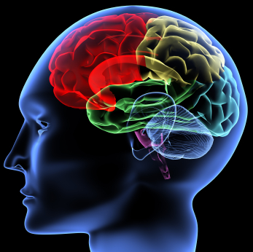
Cognition
Eating Disorders
Attention
Memory Systems
Schizophrenia
Borderlines
Hope you join us!!
Neural Correlates of Aging
Boredom
Brain Lesions
Pain
Depression
Motivational Interviewing
Therapy Process
and Outcome
Cancer Survivors
Health Psychology!
Therapy Narratives
Positive Psychology!

