Slide 1
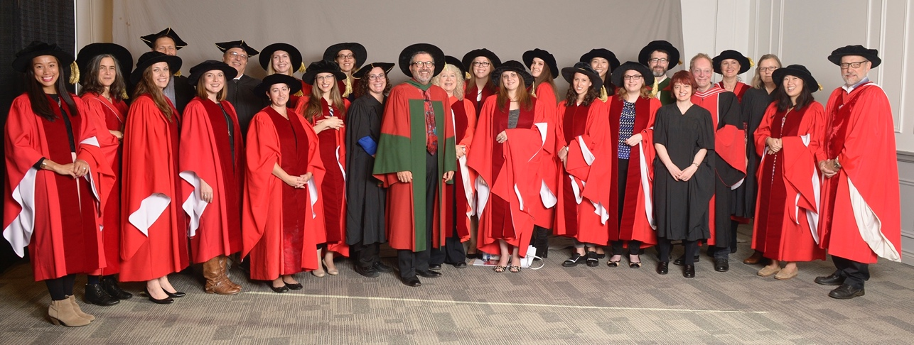
The Year in Review
2016
Department of Psychology

Slide 2
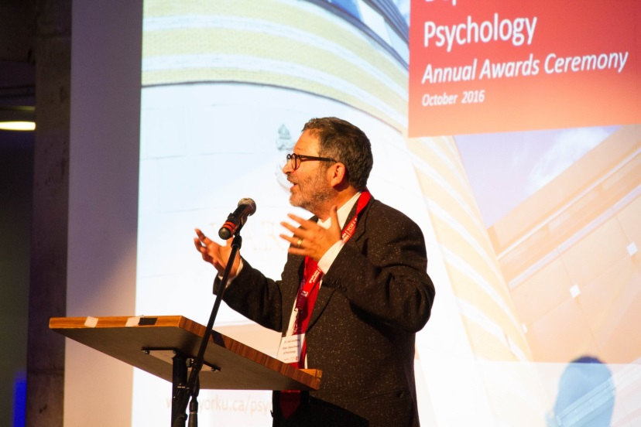
Welcome From The Chair
The address for the York University Psychology Department is on our Keele Campus in Toronto Ontario Canada but we are really located in the inspired efforts of our faculty, our contract instructors, our staff and our students. Our strength comes from our diversity, both in the voices of the people who are our department and in the breadth of interests which we explore. From studies in outer space to inner space. From what makes seniors trip and fall to what makes memories break. From studies of infancy to mental health disorders of childhood through the challenges of adolescence to adulthood and old age. From bilingualism to perfectionism. From pain to resilience. From how we see to how we are seen. From what enhances empathy to how emotional-focus helps us change.
Our intellectual journeys lead us to embrace quantitative and qualitative scientific understandings. We study at cellular and molecular levels and use
advanced neuroscience technology. We engage the humanity which makes us people but are also fascinated by animals and the eco-system that supports us. We look back both appreciatively and critically at our rich historical legacies to inform our forward outlooks. Our scholars are concerned with the major issues that our society faces, from bullying to racism, asking questions that really matter and preparing students to be thoughtful and active.
We are not content to just talk the talk, but we walk the walk in developing research in our local communities, in collaborations with colleagues
around our nation and in countries throughout the globe. Our 2016 QS World University Ranking was in the top 100 of all Psychology Departments, reflecting our collective accomplishments and the accumulated intensity of our research and practice. We hope you enjoy the glimpse of Psychology at York University that is provided through these pages and that it inspires you to speak with us and come visit us in person soon.
Dr. Joel Goldberg
Chair,
Department of Psychology
Right: Dr. Goldberg speaking at The Annual Psychology Awards Ceremony in October 2016

Slide 3
Table of Contents
Research Accomplishments
Selected books, chapters, and talks produced by our faculty and students.
BRAIN, BEHAVIOUR, AND COGNITIVE SCIENCES: 1
1
CLINICAL PSYCHOLOGY: 5
CLINICAL-DEVELOPMENTAL PSYCHOLOGY: 9
DEVELOPMENTAL SCIENCE: 13
HISTORY AND THEORY OF PSYCHOLOGY:15
SOCIAL AND PERSONALITY PSYCHOLOGY: 17
QUANTITATIVE METHODS: 20
New Faculty Members
21
Our Faculty Awards
GRANTS: 22
HONOURS: 32
CANADA RESEARCH CHAIRS AND YORK RESEARCH CHAIRS: 34
22
Organized Research Units (ORUs)
ORU connections with York Psychology faculty.
35
Our Research in the Media
Selected media coverage of our faculty’s research discoveries.
38
Our Research in the Community
Some key examples of the interface between our Faculty’s research and the
community.
42
Emerging Researchers: Our Students & Post- Doctoral Fellows
Highlighted accomplishments.
44

Slide 4
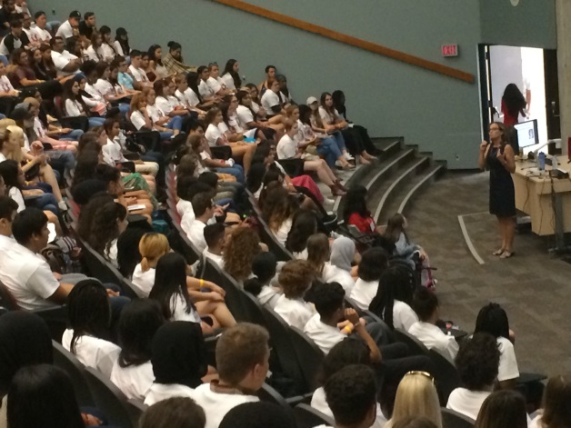
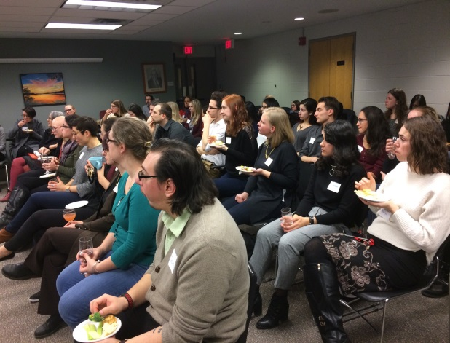
Table of Contents
Psychology Unlocked: Experiential Learning Moments
52
The York Teaching Community: Contract Faculty Contributions
54
Psychology Staff: Honouring Long-Service Psychology Administrative Staff Members
55
Partnering with Colleges: Spotlight–York-Seneca Rehabilitation Services Certificate Program (RSCP)
56
Clinical Training in Action: York University Psychology Clinic (YUPC)
57
59
Editorial Team/Contact Us

Slide 5
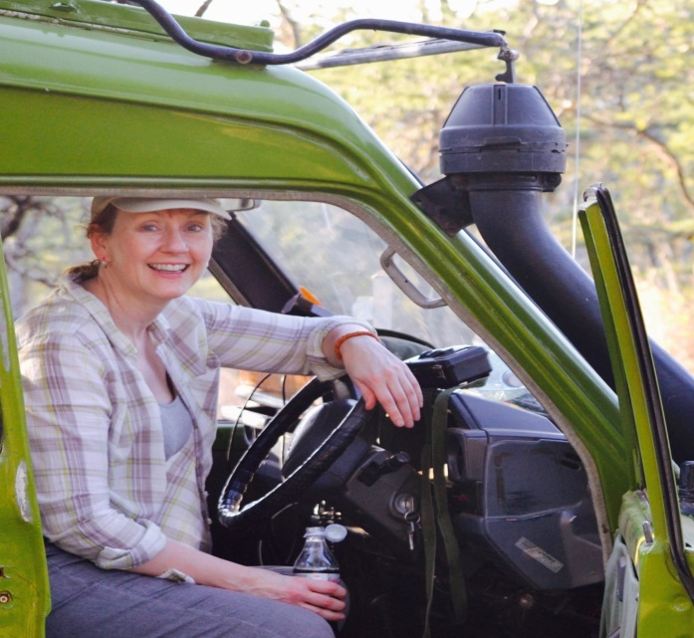
Research Accomplishments
Brain, Behaviour, & Cognitive Sciences
*Ayala, M., ‘t Hart, B.M., Henriques, D.Y.P. (2015) Concurrent adaptation to opposing visuomotor rotations by varying hand and body postures. Exp Brain Res. 233, 3433-45.
*Cappadocia,D.C., Monaco, S., *Chen, Y., Blohm, G.,& Crawford, J. D (2016/2017). Temporal evolution of target representation, movement direction planning, and reach execution in occipital-parietal-frontal cortex: an fMRI study Cerebral Cortex CerCor-2016-00320 (e-pub ahead of print).
Carnevale MJ, Harris LR (2016) “Which way is up for a high pitch?” Multisensory Research 29: 113-132.
*Daemi, M., Harris, L. R., & Crawford, J. D. (2016). Causal Inference for Cross-Modal Action Selection: A Computational Study in a Decision Making Framework. Frontiers in Computational Neuroscience 23;10:62
Dash, S., *Alipour-Nazari, S., Yan, X., Wang, H., & Crawford, J. D (2016). Superior colliculus responses to attended, unattended, and spatially updated saccade targets during smooth pursuit eye movement. Frontiers in Systems Neuroscience 2016 Apr 12;10:34.
Left: Dr. Suzanne MacDonald in Kenya, Africa waiting for hyenas after nightfall.
Note: Faculty members’ names are red; Psychology students’ names are red and have an asterisk next to them.
1

Slide 6
Research Accomplishments
*D’Amour S, Harris LR (2016) "Long-range tactile masking occurs in the postural body schema" Experimental Brain Research 234: 569-575
Dragan MC, Leonard TK, Lozano AM, McAndrews MP, Ng K, Ryan JD, Tang-Wei DF, Wynn JC, and Hoffman KL .Pupillary responses and memory-guided visual search reveal age-related and Alzheimer’s-related memory decline. (in press) Behavioural Brain Research
Dunkley, B., *Baltaretu, B., & Crawford, J. D (2016). Trans-saccadic Interactions in human parietal and occipital cortex during the retention and comparison of object orientation. Cortex 82:263-276.
*Dupuis-Desormeaux, M., Davidson, Z., Mwololo, M., Kisio, E., & MacDonald, S.E. (2016). Usage of specialized fence-gaps in a black rhinoceros conservancy in Kenya. African Journal of Wildlife Research 46(1): 22-32.
*Fraser, LE Harris LR (2016) “Perceived finger orientation is biased towards functional task spaces” Experimental Brain Research 234: 3565-3574.
Greb H, Hermann S, Dirks P, Ommen G, Kretschmer V, Schultz K, Zoidl G, Weiler
R, Janssen-Bienhold U. Complexity of gap junctions between horizontal cells of
the carp retina. Neuroscience. 2017 Jan 6;340:8-22.
Harris LR, Jenkin M, Jenkin H, Zacher JE, Dyde RT (2017) “The effect of long-term exposure to microgravity on the perception of upright”. Nature Partner Journal: Microgravity 3:3
*Hartle B, and Wilcox LM (2016) Depth magnitude from stereopsis: Assessment techniques and the role of experience. Vision Research, 125, 64-75.
Hoover AEN, *Elzein Y, Harris LR (2016) "Left-handers show no self-advantage when identifying delayed visual feedback concerning an active movement” Experimental Brain Research 234: (7) 1915-1923.
2

Slide 7
Research Accomplishments
Dunkley, B., *Baltaretu, B., & Crawford, J. D (2016). Trans-saccadic Interactions in human parietal and occipital cortex during the retention and comparison of object orientation. Cortex 82:263-276.
MacDonald, S.E. & Ritvo, S. (2016). Comparative Cognition out of the Laboratory. Comparative Cognition and Behavior Reviews, 11: 49-62.
Mueller, A. S., Gonzålez, E. G., McNorgan, C., Steinbach, M. J., & Timney, B. (2016). Effects of spatial andf temporal constraints on the perception of visual acceleration. Perception 45, 670-683.
Murray, R. F. (2016). Classification images in a very general decision model. Vision Research, 123, 26-32.
Nady A, Peimani AR, Zoidl G, Rezai P. A Microfluidic Device for Head Immobilization,
Chemical Exposure, and Behavioral Screening of Zebrafish Larva, in International Conference on Miniaturized Systems for Chemistry and Life Sciences (MicroTAS 2016). 2016: Dublin, Ireland. p. 475-476.
*Ritvo, S.E., & MacDonald, S.E. (2016). Music as enrichment for Sumatran orangutans (Pongo abelii). Journal of Zoo and Aquarium Research 4(3), 156-163.
*Ruttle, J.E., Cressman, E.K., ’t Hart, B.M., Henriques, D.Y. (2016) Time Course of Reach Adaptation and Proprioceptive Recalibration during Visuomotor Learning. PLoS ONE
*Sajad, A., Sadeh, M., #Yan, X., #Wang, H., & Crawford, J. D. (2016). Transition from Target to Gaze Coding in Primate Frontal Eye Field During Memory Delay and Memory-Motor Transformation. eNeuro 3 (2), ENEURO. 0040-16.
Silverman, I. and Choi, J. Spatial Navigation and Landscape Preferences. In The Handbook of Evolutionary Psychology. Wiley, 2016, pp 225-245.
Smith, K.W., Balkwill, L-L.Vartanian, O., Goel, V. (2015). Syllogisms delivered in an angry voice lead to improved performance and engagement of a different neural system compared to neutral voice. Frontiers in Human Neuroscience, 9: 273.
3

Slide 8
Research Accomplishments
Siu RC, Smirnova E, Brown CA, Zoidl C, Spray DC, Donaldson LW, Zoidl G.
Structural and Functional Consequences of Connexin 36 (Cx36) Interaction with
Calmodulin. Front Mol Neurosci. 2016 Nov 18;9:120.
Steinbach, M.J. (2016) Research Highlight: Distribution of palisade endings across species suggests they function in vergence eye movement control. Investigative Ophthalmology & Visual Science; 57(3):948-948.
Tsirlin I, Wilcox LM, Allison RS (2016) Size matters: Perceived depth magnitude varies with stimulus height. Vision Research, 123, 41-45.
Below: *Yasmeenah El-Zein, student of Dr. Laurence Harris, stands in front of the Tumbling Room. She will be using this device to look at the effect of background motion on the visibility of stationary objects.
4

Slide 9
Research Accomplishments
Clinical Psychology
Angus, L., Boritz,T., *Bryntwick, E., *Carpenter, N., *Macaulay, C. & *Khattra, J. (2016). The Narrative-Emotion Process Coding System 2.0 : A multi-methodological approach to identifying and assessing narrative-emotion process markers in psychotherapy. Psychotherapy Research.
*Aviram, A., Westra, H.A., Constantino. M.J., & Antony, M.M. (2016). Responsive management of early resistance in cognitive behavioral therapy for generalized anxiety disorder. Journal of Consulting and Clinical Psychology, 84(9), 783-794.
*Azam, M.A., Katz, J., Mohabir, V., & Ritvo, P. (2016). Individuals with tension and migraine headaches exhibit increased heart rate variability during post-stress mindfulness meditation practice but not during a post-stress control condition – A randomized, controlled experiment. International Journal of Psychophysiology, Dec., 110, 66-74.
*Baker, S.W., Vieweg, P., Gao, F.Q., Gilboa, A., Wolbers, T., Black, S.E., & Rosenbaum, R.S. (2016). A necessary role for the dentate gyrus of the hippocampus in pattern separation in humans. Current Biology, 26, 2629-2634.
*Carson, N., Murphy, K.J., Moscovitch, M., & Rosenbaum, R.S. (2016). The influence of the self-reference effect on enhancing memory in older adults. Memory, 24, 1157-1172.
*Colosimo, K., Nissim, R., Pos, A. E., Hales, S., Zimmerman C., Rodin, G (in press).” Double awareness" in psychotherapy for patients living with advanced cancer. Journal of Psychotherapy Integration.
*Fashler, S., & Katz, J. (2016). Keeping an eye on pain: Investigating visual attention biases in individuals with chronic pain using eye-tracking methodology. Journal of Pain Research, 9, 551–561.
*Fernandes, H., Park, N.W., & Almeida, Q. (2016). The effects of practice and delays on tool-related motor skill learning and retention in Parkinson’s disease. Presented at the Canadian Society for Psychomotor Learning and Sport Psychology (SCAPPS), Waterloo, Ontario, Canada.
5

Slide 10
Research Accomplishments
Friedlander, M., Angus, L. Wright, S., Gunther, C., Austin, C., Kangos, K., Barbaro, L., *Macaulay, C., *Carpenter, N. & *Khattra, J. (2016) “If Those Tears Could Talk, What Would They Say?” Multi-Method Analysis of a Corrective Experience in Brief Dynamic Therapy. Psychotherapy Research.
Fuentes, A., *Deotto, A., Desrocher, M., DeVeber, G., & Westmacott, R. (2016). Working memory outcomes following unilateral arterial ischemic stroke in childhood. Child Neuropsychology. 27(2): 1-19.
*Hartman, L.I., Fergus, K.D., & Reid, D.W. (2016). Psychology's Gordian Knot: Problems of identity and relevance. Canadian Psychology, 57, 149-159.
*Hunter, J. A., Abraham, E. H., *Hunter, A. G., Goldberg, L. C., & Eastwood, J. D. (2016). Personality and boredom proneness in the prediction of creativity and curiosity. Thinking Skills and Creativity, 22, 48-57.
*Hunter, A. G., & Eastwood, J. D. (2016). Does boredom cause attention failures? Examining the relations between trait boredom, state boredom, and sustained attention. Experimental Brain Research.
*Hunter, A.G., *Hunter, J.A., & Eastwood, J.D. (2016). Boredom propensity. In Encyclopedia of Personality and Individual Differences. Springer International Publishing.
*Ianakieva, I., Fergus, K., *Ahmad, S., Pos, A.E., & Pereira, A. (2016). A model of engagement promotion in a professionally facilitated online intervention for couples affected by breast cancer. Journal of Marital and Family Therapy 42(4), 701-715.
*Male, D., Fergus, K., & *Cullen, K. (2016). Sexual identity after breast cancer: Sexuality, body image, and relationship repercussions. Current Opinion in Supportive and Palliative Care, 10, 66-74.
The best part of the past year at York University was…….
Learning that the Clinical Psychology program received re-accreditation for the next 7 years from the Canadian Psychological Association, and that the Clinical Neuropsychology program received accreditation for a 3-year period. We are the first (and only) accredited clinical neuropsychology program in English-speaking Canada.
Dr. Jill Rich, Director of Clinical Training
6

Slide 11
Research Accomplishments
*Khattra, J., Angus, L., Westra, H. & *Macaulay, C. (in press). Client corrective experiences in Motivational Interviewing/Cognitive Behavioral treatment for Generalized Anxiety Disorder : A qualitative analysis. Psychotherapy Integration.
Mills, J.S., Vu, N., Manley, R., & Tse, S. (2016, September). Adolescent and young adult women’s opinions of common eating disorder prevention messages. Paper presented at the 5th Biennial Conference of the Eating Disorders Association of Canada, Winnipeg, MB.
*Macaulay, C., Angus, L., *Khattra, J., Westra, H., & Ip, J. (in press). Client retrospective accounts of corrective experiences in motivational interviewing integrated with cognitive behavioral therapy for generalized anxiety disorder. Journal of Clinical Psychology: In Session. 73,2.
*McCarthy, M., Fergus, K.D., Miller, D. (2016). I-We boundary fluctuations in couple adjustment to colorectal cancer and life with a permanent colostomy. Health Psychology Open, 3, 1-14.
Pos, A. E. & *Choi, B. (in press). Relating Process to Outcome in Emotion-Focused Therapy. Rhonda Goldman & Leslie Greenberg (Eds.). The clinical handbook of Emotion-focused therapy. Publication ETA 2017, DC, APA
Pos, A. E. & *Paolone, D. A. (in press ) EFT for Personality Disorders (submitted). Rhonda Goldman & Leslie Greenberg (Eds.). The clinical handbook of Emotion-focused therapy. Publication DC, APA
Pos, A. E., *Paolone, D. A., Smith, C.E. & Warwar, S. H. (in press) How does client expressed emotional arousal relate to outcome in experiential therapy for depression? Person–centered and Experiential Psychotherapies. Taylor & Francis. Oxford, UK
*Rabin, J.S., *Olsen, R.K., Gilboa, A., Buchsbaum, B., & Rosenbaum, R.S. (2016). Using fMRI to understand event construction in developmental amnesia. Neuropsychologia, 90, 261-273.
*Rosenbloom, B.R., Katz, J., Chin, K., Haslam, L., Canzian, S., Kreder, H.J., & McCartney, C.J.L. (2016). Predicting pain outcomes after traumatic musculoskeletal injury. Pain, 157(8), 1733-1743.
7

Slide 12
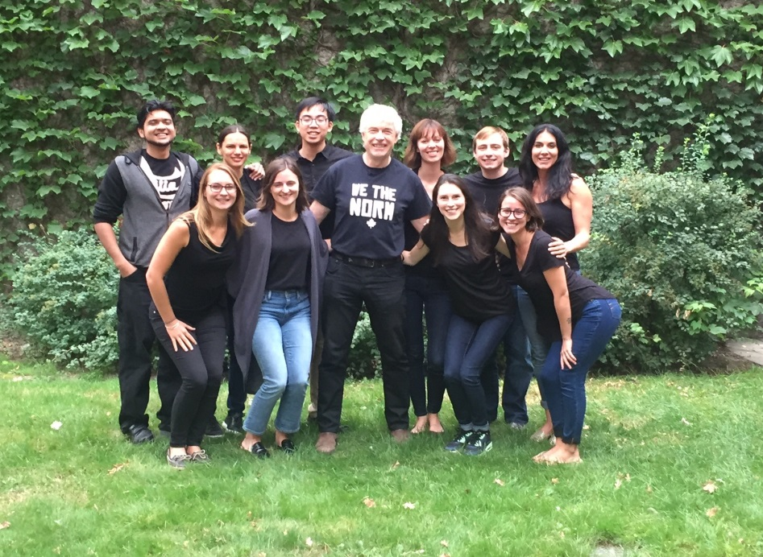
Research Accomplishments
*Roosen, K., & Mills, J.S. (2016). What persons with physical disabilities can teach us about obesity. Health Psychology Open, January-June: 1-3.
Roy, S., & Park, N.W. (2016). Effects of divided attention on memory for declarative and procedural aspects of tool use. Memory & Cognition, 44, 727-739.
Shentow-Bewsh, R., Keating, L., & Mills, J.S. (2016). Effects of anti-obesity messages on women’s body image and eating behaviour. Eating Behaviors, 20, 48-56.
Sijercic, I., *Button, M.L., Westra, H.A., & *Hara, K.M. (2016). The interpersonal context of client motivational language in cognitive behavioral therapy. Psychotherapy, 53, 13-21.
Westra, H.A., Constantino, M.J., & Antony, M.M. (2016). Integrating motivational interviewing with cognitive behavioral therapy for severe generalized anxiety disorder: An allegiance-controlled randomized clinical trial. Journal of Consulting and Clinical Psychology, 84(9), 768-782.
*Yao, C., Rich, J. B., Tannock, I. F., Seruga, B., & Bernstein, L. J. (2016). Pretreatment differences in intraindividual variability in reaction time between women diagnosed with breast cancer and healthy controls. Journal of the International Neuropsychological Society, 22(5), 530-539
Dr. Norm Park and the MA-2 Clinical Cohort (April 2016)
8

Slide 13
Research Accomplishments
Clinical-Developmental Psychology
Amato MP, Krupp LB, Charvet LE, Penner I-K, Till C. (2016). Pediatric multiple sclerosis: Cognition and mood. Neurology, 87: S82-87.
Ames, M.E., Wintre, M.G., Flora, D.B. (2015). Trajectories of BMI and Internalizing Symptoms: Associations across Adolescence. Journal of Adolescence, 45, 80-88. (refereed).
Bohr, Y., Liu, C. & Chen, S. (in Press). Satellite Babies: Costs and benefits of culturally driven parent-infant separations in North American immigrant families. In de Guzman, M.R.T., Brown, J. & Pope Edwards, C. (Editors). Parenting From Afar: The Reconfiguration of the Family Across Distance. Oxford University Press.
Bohr, Y., Litwin, L., Flett, G., Rawana, J., G., Healy, G. & Dion, S. (2016). Making SPARX fly in Nunavut: Pilot testing an innovative computer-based intervention for reducing youth depression as a preamble to the development of a culturally specific, community led prevention program. Research report prepared for the Department of Health, Government of Nunavut.
*Chavoshi, S., Wintre, M.G., & Wright, L. (2016). A Developmental Sequence Model to University Adjustment of International Undergraduate Students (DSMUA). Journal of International Students (in press).
Classen, C., *Zozella, K.P.M., *Keating, L, Ross, D., & Muller, R. T. (2016, April). Examining the interplay of attachment, alexithymia, and emotion regulation on trauma-related outcomes among women who completed a brief, intensive multi-modal program for adult survivors of child abuse. Symposium presented at the 33rd annual conference of the International Society for the Study of Trauma & Dissociation. San Francisco, California, U.S.A.
*Dentakos, S., Wintre, M.G. *Chavoshi, S. & Wright, L. (2016). Acculturation Motivation in International Student Adjustment and Permanent Residency Intentions: A Mixed-Methods Approach. Emerging Adulthood,4 , 1-15. (refereed).
*Jeong, J., Pepler, D., Motz, M., DeMarchi, G., & Espinet, S. (2015). Readiness for treatment: Does It matter for women with substance use problems who are parenting? Journal of Social Work Practice in Addiction, 15, 394-417
9

Slide 14
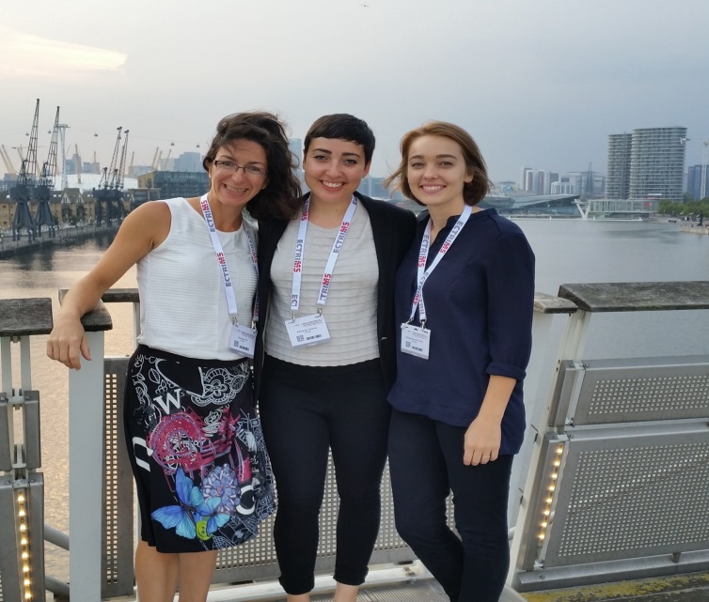
Research Accomplishments
*Levin, R. & Rawana, J.S. (2016). Attention-Deficit/Hyperactivity Disorder and Eating Disorders across the lifespan: A systematic review of the literature. Clinical Psychology Review, 50, 22-36.
Muller, R. T. (2015). آسیب‌های روانی و مراجع اجتنابی, translated by Touraj S. Banab & Reza Babri. Tehran, Iran: Sepand Minoo Publishing. Farsi (Iranian) Translation.
Pepler, D., Cummings, J. & Craig, W. (2016). Healthy Development, Healthy Communities. Volume 4, PREVNet Series.
Perry, A., Koudys, J., Dunlap, G., & Black, A. Autism Spectrum Disorder. (in press). In M. Wehmeyer, K. Shogren, & A. Fung (Eds.). A Comprehensive Guide to Intellectual and Developmental Disabilities. Brookes.
Perry, A., Koudys, J., & *Blacklock, K. (2016). Early intensive behavioural intervention and training. In N.N. Singh (Ed.), Clinical Handbook of Evidence-based Practices for Individuals with Intellectual Disabilities. Springer.
*Racine, N., Pillai Riddell, R, Flora, D., Taddio, A., Greenberg, S., and Garfield. H. (2016). Preschool Anticipatory Distress to Immunization Pain: Understanding Development. Pain. Sep;157(9):1918-32.
Above: Dr. Christine Till with two of her graduate students *Elisea De Somma and *Emily Barlow-Krelina at the European Committee for Treatment and Research in Multiple Sclerosis (ECTRIMS) in London, England (Sept. 2016)
10

Slide 15
Research Accomplishments
Rawana, J.S., *McPhie, M.L., & *Hassibi, B. (2016). Eating- and weight-related factors associated with depressive symptoms in emerging adulthood. Eating Behaviors, 22, 101-108.
*Royer-Gagnier, K., Skilling, T.A., Brown, S.L., Moore, T.E., & Rawana, J.S. (2016). The Strengths Assessment Inventory – Youth Version: An evaluation of the psychometrics properties with male and female justice-involved youth. Psychological Assessment, 28(5), 563-574.
*Rependa, S. L., *Cordeiro, K., & Muller, R. T. (2016, April). Trauma Practice: A tri-phasic model of adult trauma therapy. Paper presented at the 33rd annual conference of the International Society for the Study of Trauma & Dissociation. San Francisco, California, U.S.A.
Smarandache, A., Kim, T. H., Bohr, Y., & Tamim, H. (2016). Predictors of a negative labour and birth experience based on a national survey of Canadian women. BMC pregnancy and childbirth, 16(1), 1.
Stanovich, K. E., West, R. F., & Toplak, M. E. (2016). The Rationality Quotient (RQ): Toward a Test of Rational Thinking. Cambridge, MA: MIT Press.
Till C., Nogeura A, Verhey LH, O’Mahony J, Yeh A, Mah J, Sinopoli KJ, Brooks BL, Aubert-Broche B, Collins DL, Narayana S, Arnold D, Banwell BL. (In press). Cognitive and behavioural functioning in children six months after an acute demyelinating syndrome. Journal of International Neuropsychological Society, in press.
Wintre, M.G., Kandasamy, A., *Chavoshi, S., & Wright, L. (2015). Are International Undergraduate Students Emerging Adults? Motivations for Studying Abroad.
Emerging Adulthood, 3, 255-264.
Student Highlight: *Ashley Malin (as told by her supervisor Christine Till)
A Clinical Psychology graduate student, conducted an epidemiologic study, which provided a compelling addition to the current debate about the safety of water fluoridation. To illustrate the significance of this research, statistics compiled by Environmental Health show that her article was the third most viewed article in 2015 (accessed over 25,000 times!). I am proud to say that Ashley was selected for the 2015 Norman S. Endler Research Fellowship for her outstanding research contribution to children's environmental health. She is now embarking on a post-doctoral fellowship at the Icahn School of Medicine at Mount Sinai in New York City.
11

Slide 16
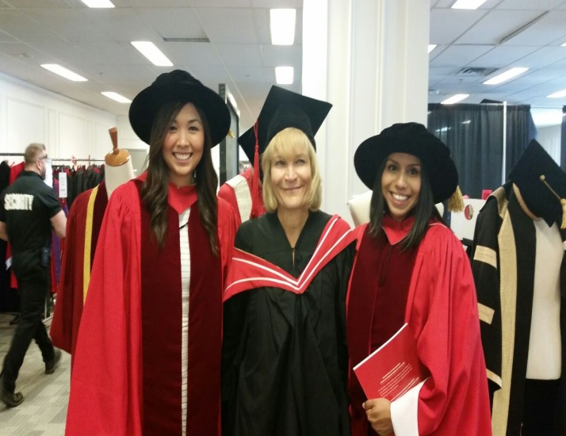
Research Accomplishments
Toplak, M. E., Hosseini, A., & *Basile, A. G. (2016). Temporal discounting and associations with cognitive abilities and ADHD-related difficulties in a developmental sample. In M. E. Toplak & J. Weller (Eds.), Individual Differences in Judgment and Decision Making: A Developmental Perspective. London Psychology Press.
Toplak, M. E. & Weller, J. (Editors) (2016). Individual Differences in Judgment and Decision Making: A Developmental Perspective. London: Psychology Press.
*Waxman, J., Pillai Riddell, R. R., *Pinhasov, A., Schmidt, L. A., Tablon, P. (2016). Development of cardiovascular indices of acute pain responding in infants: A systematic review and meta-analysis. Pain Research and Management
Weiss, J. A., Cappadocia, M. C., *Tint, A., & Pepler, D. (2015). Bullying victimization, parenting stress, and anxiety among adolescents and young adults with autism spectrum disorder. Autism research, 8(6), 727-737.
Weiss, J., *Ting, V., & Perry, A. (2016). Psychosocial correlates of maladaptive behaviour and psychiatric diagnoses in youth with severe developmental disability. Journal of Intellectual Disability Research, 60(6), 583-593.
Taheri, A., Perry, A., & Minnes, P. (2016). Examining the social participation of children and adolescents with Intellectual Disabilities and Autism Spectrum Disorder in relation to peers. Journal of Intellectual Disability Research, 60(5), 435-443. DOI: 10.1111/jir.12289
*Tint A., & Weiss, J. A. (2016). Family wellbeing of individuals with autism spectrum disorder: A scoping review. Autism, 20(3), 262-275.
Left: Dr. Yvonne Bohr with *Bramilee Dhayanandhan and *Jessica Chan at the 2016 graduation ceremony.
12

Slide 17
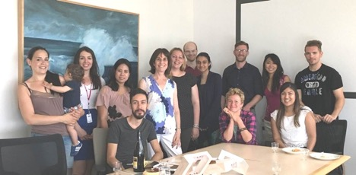
Research Accomplishments
Developmental Science
Arsalidou, M., Pascual-Leone, J., & Johnson, J. (2016, January). Quantifying cognitive limitations behaviourally and with neuroimaging. Budapest CEU Conference on Cognitive Development, Budapest, Hungary.
Arsalidou, M., & Pascual-Leone, J. (2016). Constructivist developmental theory is needed in developmental neuroscience. npj Science of Learning, 1, 16016.
Arsalidou, M., & Pascual-Leone, J., Jabbari, Y., & Gordon, M. (2016, August). Working memory capacity in young adult bilinguals. 8th European Working Memory Symposium, Liege, Belgium.
Barac, R., *Moreno, S., & Bialystok, E. (2016). Behavioral and electrophysiological differences in executive control between monolingual and bilingual children. Child Development, 87, 1277-1290.
Bialystok, E., & *Sullivan, M.D. (Eds.) (2016). Bilingualism and ageing: Special issue of Linguistic Approaches to Bilingualism. Amsterdam: John Benjamins Publishing.
Bialystok, E., Abutalebi, J., Bak, T.H., Burke, D.M., & Kroll, J.F. (2016). Aging in two languages: Implications for public health. Ageing Research Reviews, 27, 56-60.
*Comishen, K., Yee, A., *Wong-Kee-You, A.M.B., & Adler, S.A. (2016, May). Differential attentional responding in caesarean versus vaginally delivered adults. Paper presented at the Canadian Association for Neuroscience Satellite Symposium: Toronto, Canada.
Right: Dr. Ellen Bialystok and the Lifespan Cognition and Development Lab
13

Slide 18
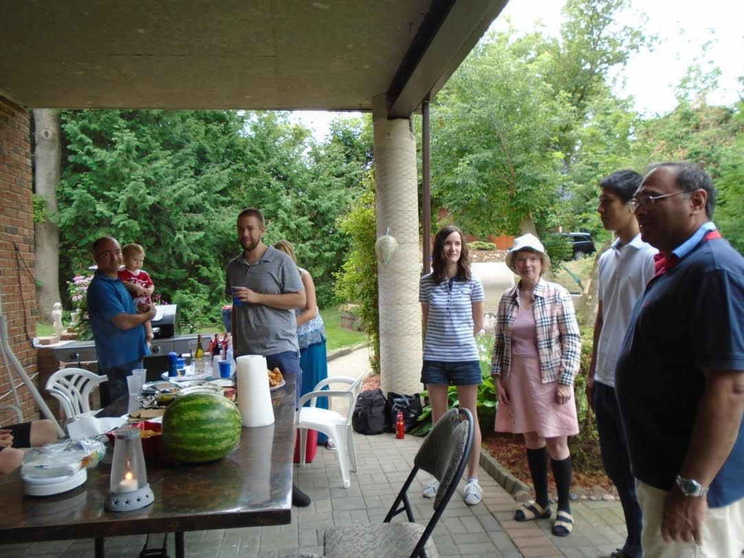
Research Accomplishments
Goel, V. (2015). Indeterminacy tolerance as a basis of hemispheric asymmetry within prefrontal cortex. Frontiers in Human Neuroscience, 9: 326.
Goel, V., Eimontaite, I., Goel, A., & Schindler, I. (2015). Differential modulation of performance in insight and divergent thinking tasks with tDCS. Journal of Problem Solving. Vol. 8, Iss. 1, Article 2.
Johnson, J., Pascual-Leone, J., *Giuliano, M., Kumar, G., Barker, R., & *Labrish, C. (2016, June). Longitudinal growth of mental-attentional capacity. Jean Piaget Society, Chicago, IL.
Kim, T.H.M., Pascual-Leone, J., Johnson, J., & Tamim, H. (2016). The mental-attention Tai Chi effect with older adults. BMC Psychology, 4:29.
*Spreng, R.N., *Stevens, W.D., Viviano, J.D., & Schacter, D.L. (2016). Attenuated anticorrelation between the default and dorsal attention networks with aging: evidence from task and rest. Neurobiology of Aging, 45, 149-160. (*Equal Contribution)
Stevens, W.D., *Khan, N., Kravitz, D.J., Peng, C.S., Tessler, M.H., & Martin, A. (2016). The visual word form area is highly specialized for processing real words. 46th Annual Meeting of the Society for Neuroscience (San Diego, CA).
*Solomon-Harris, L.M., *Khan, N.A., Replete, C.S., Peng, C.S., Stevens, W.D., & Martin, A.(2016). Atypical lateralization of face processing in autism spectrum disorders. 46th Annual Meeting of the Society for Neuroscience (San Diego, CA).
*Wong-Kee-You, A.M.B., & Adler, S.A. (2016). Anticipatory eye movements and long-term memory in early infancy. Developmental Psychobiology, 58, 841-851.
Most interesting research finding of the year: Showing that performance on creativity tasks can be both decreased and increased with simple brain stimulation techniques like tDCS.
Dr. Vinod Goel
Left: Dr. Goel and the members of his lab at their annual BBQ.
14

Slide 19
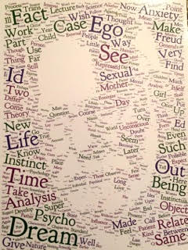
Research Accomplishments
History and Theory of Psychology
Green, C. D. (2016). A digital future for the history of psychology? History of Psychology, 52, 209-219.
Green, C. D., Heidari, C., Chiacchia, D., & Martin, S. M. (2016). Bridge over troubled waters? The most “central” members of psychology and philosophy associations ca. 1900. Journal of the History of the Behavioral Sciences, 52, 279-299.
Green, C. D. & Feinerer, I. (2016). The evolution of the American Journal of Psychology 2, 1904-1918: A network investigation. American Journal of Psychology, 129, 185-196.
Rutherford, A. (in press). Surveying rape: Feminist social science and the ontological
politics of sexual assault. History of the Human Sciences.
Rutherford, A. (2016, April). Feminist psychology as public science. Invited presentation,
Conference on “Psychology and its Publics from the Cold War to the Present,” Sigmund Freud University, Vienna, Austria.
Left: From Dr. C. Green: A word cloud of Sigmund Freud, composed of the most common words that appeared in New Introductory Lectures on Psychoanalysis (Norton, 1933). Presented at the joint conference of Cheiron and the European Society for the History of the Human Sciences in Barcelona, Spain (June 2016).
15

Slide 20
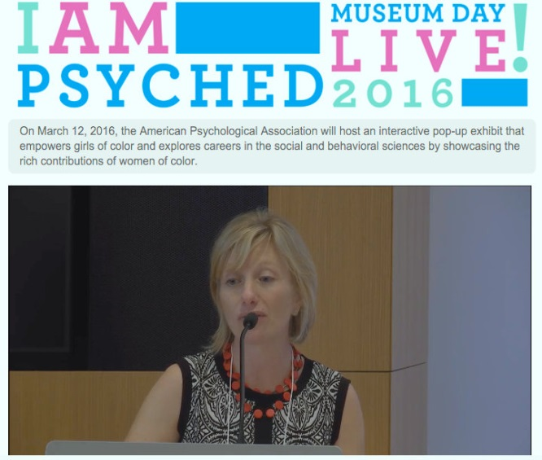
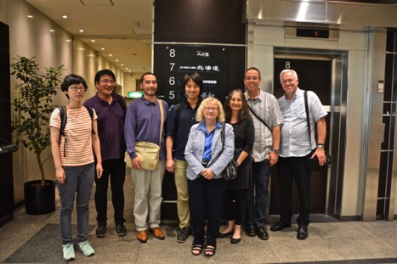
Research Accomplishments
*Fox Lee, S., Rutherford, A., & Pettit, M. (2016). “Functionalism, Darwinism, and the Psychology of Women” as critical feminist history of psychology: Discourse communities and citation practices. Feminism & Psychology, 26 (3), 254-271.
Teo, T. (2016). Embodying the conduct of everyday life: From subjective reasons to privilege. In E. Schraube & Ch. Hojholt (Eds.), Psychology and the conduct of everyday life (pp.111-123). London: Routledge.
Teo, T. (2016). Acquired color blindness: How a deficiency became a virtue [Review of the book The myth of racial color blindness: Manifestations, dynamics, and impact, by H, A. Neville, M. E. Gallardo, and D. Wing Sue (Eds.)]. PsycCRITIQUES, 61(6).
Teo, T. (2016, July). Critical psychologies, indigenous realities, and the problem of truth. In T. Teo (Organizer), Critical Psychology around the World (II): Dialectics of critiquein indigenous and global psychologies. Symposium conducted at the 31st International Congress of Psychology, Yokohama, Japan.
Below: Members of the ISTP executive (International Society for Theoretical Psychology) including Dr. Thomas Teo (second from right) visiting the hosts of the 2017 ISTP conference in Tokyo, Japan.
Above: Dr. Alexandra Rutherford at the launch of the "I Am Psyched!" Smithsonian Museum Day Live exhibit and event at the APA central office in Washington, DC (March, 2016).
16

Slide 21
Research Accomplishments
Social and Personality Psychology
Cañadas, E., Lupiáñez, J., Kawakami, K., Niedenthal, P. M., & Rodríguez-Bailón, R. (2016). Perceiving emotions: Cueing social categorization processes and attentional control through facial expressions. Cognition and Emotion, 6, 1149-1163.
Flett, G.L., Goldstein, A.L., Pechenkov, I., *Nepon, T., & Wekerle, C. (2016). Antecedents, correlates, and consequences of feeling like you don’t matter: Associations with maltreatment, loneliness, social anxiety, and the five factor model. Personality and Individual Differences, 92, 52-56.
Flett, G.L., & Hewitt, P.L. (2016). Still measuring perfectionism after all these years: Reflections and an introduction to the Special Issue on advances in the assessment of perfectionism. Journal of Psychoeducational Assessment, 34, 615-619.
Flett, G.L., Hewitt, P.L., Besser, A., Su, C., Vaillancourt, T., Boucher, D., Munro, Y., Davidson, L., & Gale, O. (2016). The Child-Adolescent Perfectionism Scale: Development, psychometric properties, and associations with stress, distress, and psychiatric symptoms. Journal of Psychoeducational Assessment, 34, 634-652.
Flett, G.L., Hewitt, P.L., & *Nepon, T. (2016). Perfectionism, worry, and rumination in health and mental health: A review and a conceptual framework for a cognitive theory of perfectionism. In F. M.Sirois & D.S. Molnar (Eds.), Perfectionism, health, and well-being (pp. 121-156). New York; Springer.
Gomillion, S., Gabriel, S., Kawakami, K., & Young, A. F. (2016). Let’s stay home and watch TV: The benefits of shared media use for close relationships. Journal of Social and Personal Relationships. Online first
Gonzalez, A., Steele, J. R., & Baron, A. S. (2016). Reducing children’s implicit racial bias through exposure to positive outgroup exemplars. Child Development.
17

Slide 22
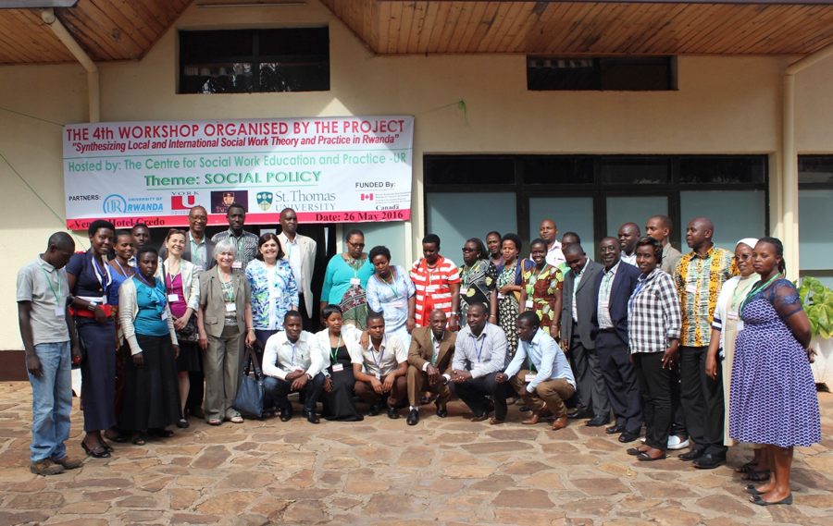
Research Accomplishments
Hynie, M., Korn, A., & Tao, D. (2016). Social context and social integration for Government Assisted Refugees in Ontario, Canada. In M. Poteet & S. Nourpanah (Eds.), After the flight: The dynamics of refugee settlement and integration (pp 183-227). Newcastle upon Tyne, UK: Cambridge Scholars.
Hynie, M., Ardern, C. I., & Robertson, A. (2016). Emergency room visits by uninsured child and adult residents in Ontario, Canada: What diagnoses, severity and visit disposition reveal about the impact of being uninsured. Journal of Immigrant and Minority Health, 18(5), 948-956.
King, R., Hynie, M., Mukashema, I., Habineza, J.P., Kubwimana, G., & Musindarwego, A. (2016). Integrating, complementary or just different? Western and Rwandan approaches to clinical counseling. Critical and Radical Social Work, 4(2), 231-248.
*Ng, A., Steele, J. R., & Sasaki, J. (2016). Will you remember me? Culture moderates face recognition biases. Journal of Experimental Social Psychology, 64, 21-26.
Above: Dr. Michaela Hynie (sixth from left) at the fourth and last workshop with colleagues in Social Work at the University of Rwanda, taken in Butare, Rwanda (May, 2016).
18

Slide 23
Research Accomplishments
*Ng, A. & Hynie, M. (2016). Naïve dialecticism and indecisiveness: Mediating mechanism and downstream consequences. Journal of Cross-Cultural Psychology (47) 263-276.
*Maslej, M. M., Oatley, K., & Mar, R. A. (in press). Creating fictional characters: The role of experience, personality, and social processes. Psychology of Aesthetics, Creativity, and the Arts.
Maxwell, J.*, Muise, A., MacDonald, G., Day, L. C.*, Rosen, N. O., & Impett, E. A. (in press). Sexpectations: The influence of implicit beliefs about sexual relationships on sexual satisfaction. Journal of Personality and Social Psychology.
Muise, A., & Impett, E. A. (2016). Applying theories of communal motivation to sexuality. Social and Personality Psychology Compass. Advanced online publication.
Muise, A., Stanton, S. C. E.*, Kim, J. J.*, & Impett, E. A. (2016). Not in the mood? Men under (not over) perceive their partner’s sexual desire in established relationships. Journal of Personality and Social Psychology, 110, 725-742.
Pauker, K., Williams, A., & Steele, J. R. (2016). Children’s racial categorization in context. Child Development Perspectives, 10(1), 33-38.
*Rain, M., *Cilento, E., MacDonald, G., & Mar, R. A. (in press). Adult attachment and transportation into narrative worlds. Personal Relationships.
Williams, A., Steele, J. R., Lipman, C. (2016). Assessing children’s implicit attitudes using the Affective Misattribution Procedure. Journal of Cognition and Development, 17, 505-525.
*Yusa, A., Hynie, M., & Mitchell, S. (2016). Utilization of internal evaluation results by community mental health organizations: Credibility in different forms. Evaluation and Program Planning, 54, 11-18
Zacks, J., Mar, R. A., & *Calarco, N. (in press). The Cognitive Neuroscience of Discourse: Covered Ground and New Directions (pp. XX–XX). In D. Rapp, A. Britt, & M. Schober (Eds.) Handbook of Discourse Processes, 2nd ed. New York, NY: Routledge.
19

Slide 24
Research Accomplishments
Quantitative Methods
*Chalmers, R.P., *Counsell, A., & Flora, D.B. (2016). It might not make a big DIF: Improved Differential Test Functioning statistics that account for sampling variability. Educational and Psychological Measurement, 76, 114-140.
*Counsell, A., & Cribbie, R. A. (in press). Using the errors-in-variables method in two-group pretest-posttest design. Methodology.
Cribbie, R. A., *Ragoonanan, C., & *Counsell, A. (in press). Testing for negligible interaction: A coherent and robust approach. British Journal of Mathematical and Statistical Psychology.
Friendly, M. & Meyer, D. Discrete Data Analysis with R: Visualization and Modeling Techniques for Categorical and Count Data. Chapman & Hall/CRC, 2016
Friendly, M. & Sigal, M. Graphical Methods for Multivariate Linear Models in Psychological Research: An R Tutorial The Quantitative Methods for Psychology, 2017, 13(1), 20-45 .
*Ng, V. & Cribbie, R. A. (in press). Modeling continuous, skewed and heteroscedastic outcomes in psychology: Is generalized modeling the best 'fit'? Current Psychology.
Pek, J., *Chalmers, R. P, & Monette, G. (2016). On the relationship between confidence sets and exchangeable weights in multiple linear regression. Multivariate Behavioral Research, 51, 719-739.
Pek, J., & Hoyle, R. H. (2016). On the (in)validity of tests of simple mediation: Threats and solutions. Social and Personality Psychology Compass, 10, 150--163.
The best part of the past year at York University was…
Working with postdoctoral research fellow *Jessica K. Flake on a systematic survey about the practice of measurement in empirical research.
- Dr. Jolynn Pek
20

Slide 25
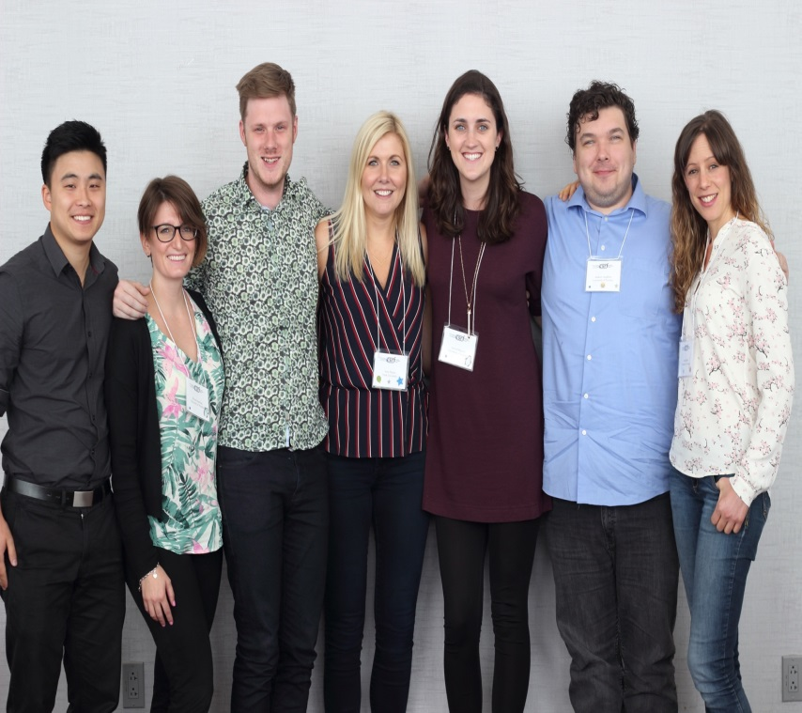
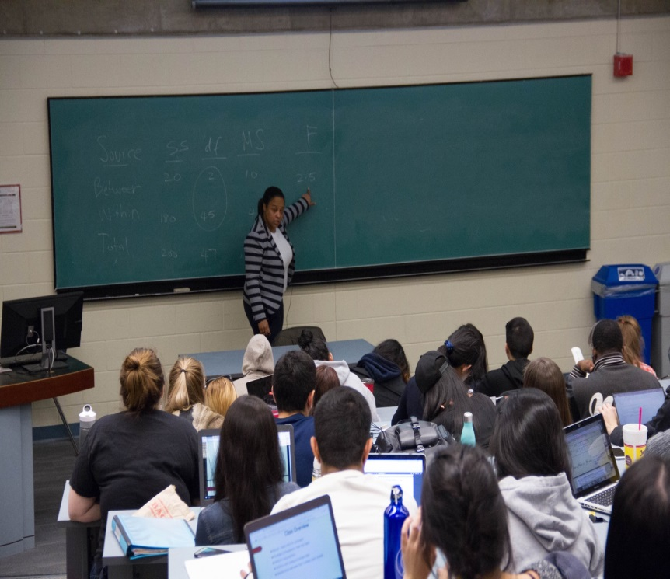
New Faculty
The Psychology Department welcomes Dr. Amy Muise to the Social-Personality area!
Dr. Muise (centre) pictured with her lab attending The Canadian Sex Research Forum in Quebec City.
The Psychology Department welcomes Dr. Monique Herbert to the Quantitative Methods Area!
Dr. Herbert teaching a class in introductory statistics.
21

Slide 26
Faculty Awards
Grants
Here are some examples of the range of the external awards to our faculty members in the 2015-2016 fiscal year (unless otherwise indicated). The amount listed is usually the amount awarded for that academic year (unless otherwise indicated for total award).
Dr. Scott Adler
The Hallward Fund of the Toronto Foundation
Exploring the caesarean section birth experience as a risk factor for attentional and cognitive development consequences: $105,000 (2016-2019)
Dr. Marie Arsalidou
NSERC- Discovery Grant
Developmental involvement of prefrontal cortex and working memory in mathematical problem solving: $26,000 (with co-investigator; Dr. Juan Pascual-Leone)
Dr. James Bebko
Counselling Foundation of Canada
Asperger and autism spectrum disorder mentorship program: $35,000
York Foundation
Asperger mentoring program: $580
Dr. Ellen Bialystok
National Institute of Health (NIH)
The mechanism of cognitive reserve in bilingualism: $188, 805.26 (with co-investigators)
Cognitive and Language Development in Bilingual Children: Mechanisms, Limitation: $276, 869.48
NSERC- Discovery Grant
Interaction of language and control processes in monolingual and bilingual cognition: $57,000
22

Slide 27
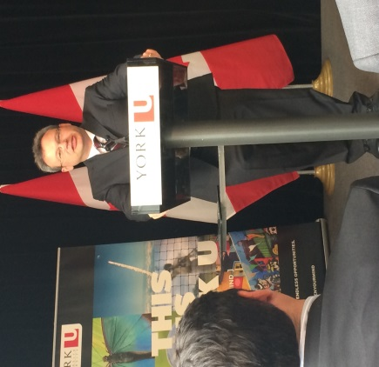
Faculty Awards
Dr. Jennifer Connolly
Ministry of Children and Youth Services
Romantic development in middle childhood, adolescence and young adulthood: An updated and expanded literature synthesis: $16,950
Dr. Doug Crawford
Canada Research Chair (Tier 1) in Visual-Motor Neuroscience: $200,000
CIHR
Neurophysiology of 3-D gaze and head control: $200,187
NSERC- Discovery Grant
Role of supramarginal gyrus in the integration of visual features across eye movements: $59,000
Canada First Research Excellence Fund (CF-REF)
Vision: Science to Applications (VISTA Program) (with the vision science co-investigators): $33,300,000
Dr. Robert Cribbie
SSHRC-Insight Grant
Advanced applications of equivalence testing: Bayesian and frequentist approaches: $42,564
Dr. Joseph DeSouza
Ontario Brain Institute: $15,000
Congratulations to the Vision Science team who were recognized for their work with the prestigious Canada First Research Excellence Fund (CF-REF) grant to support Vision: Science to Applications (VISTA). Right: Dr. Doug Crawford at the CF-REF award ceremony.
23

Slide 28
Faculty Awards
Dr. John Eastwood
NSERC
The unengaged mind: Understanding the cognitive mechanisms underlying boredom: $140,000 (5-year grant total)
Dr. James Elder
Ontario Ministry of Transportation
Automatic 3D video analytics for traffic and road condition assessment: $69,555
NSERC- Discovery Grant
Recurrent computations for the perceptual organization of shape: $36,000
NSERC
CREATE program in data analytics and visualization (with co-investigators) $300,000
Dr. Gordon Flett
SSHRC
Canada Research Chair (Tier 1) in Personality & Health: $200,000
Dr. Michael Friendly
NSERC- Discovery Grant
Graphical methods for multivariate data analysis: $11,000
Dr. Christopher Green
SSHRC- Insight Grant
Digital history of psychology: $57,550 (with co-investigator; Dr. Michael Pettit)
Dr. Laurence Harris
Canadian Space Agency
The effect of long duration hypogravity on the perception of self-motion: $85,795 (with co-investigators)
NSERC- Discovery Grant
Multisensory interactions and the representation of the body in the brain: $49,000
Canadian Foundation for Innovation/Ontario Research Fund
Full field vision and spatial orientation: $1,977,227.50
24

Slide 29
Faculty Awards
Dr. Walter Heinrichs
York University, Joint Sabbatical Leave Fellowship
Understanding poor functional outcome in cognitively normal schizophrenia: $10,875
Dr. Kari Hoffman
The Krembil Foundation/ Brain Canada
Modulating memory circuits: Focal DBS treatments to improve medial temporal lobe function: $212,468.55, $249,963 (with co-investigators)
NSERC- Discovery Grant
Integrating top-down signals in face and object processing: $29,000
Dr. Michaela Hynie
CIHR
Refugee Integration and Long-Term Health Outcomes in Canada: $270,633 (with co-investigators)
Home Suite Hope
Program Evaluation Home Suite Hope: Homeward Bound Program: $5,000
Dr. Joel Katz
CIHR
Canada Research Chair (Tier 1) in Health Psychology: $200,000
What was your most exciting research finding or activity this past year?
The most important research involved a systematic review of existing multidisciplinary chronic pain treatment facilities published by Sam Fashler highlighting, among other things, the scarcity of pain treatment facilities worldwide including the finding that in Canada there is only one pain center for every ~50,000 Canadians living with chronic pain (Fashler et al., 2016).
- Dr. Joel Katz
25

Slide 30
Faculty Awards
Dr. Kerry Kawakami
SSHRC- Insight Grant
Preferential attention to the eyes of racial and other ingroup members: $47,200
American Psychological Association
Editor: Journal of Personality and Social Psychology: Interpersonal Relations and Group Processes: $4,746.82
Dr. Richard Lalonde
SSHRC- Insight Grant
The double-edged sword of the model minority stereotype: Cognitive components, affective responses, and psychological outcomes: $30,989 (with co-investigator; Dr. Joni Sasaki)
Dr. Suzanne MacDonald
Toronto Region Conservation Authority
Road ecology citizen science monitoring: $67,000
Dr. Jennifer Mills
SSHRC- Insight Grant
The impact of appearance-based social media on young women’s body image: $32,214
Women’s College Hospital
Women’s Xchange Grant: Does a presenter’s disclosure of a past eating disorder impact the effectiveness of eating disorder prevention messages?: $15,000
Dr. Richard Murray
NSERC- Discovery Grant
Human visual perception of shape, lightness, and lighting: $32,000
Dr. Hiroshi Ono
NSERC- Discovery sub-grant
Visual functions across the lifespan: $21,265.34 (with co-investigator)
NSERC- Discovery Grant
Sensory and Motor Aspects of Space Perception: $25,000
26

Slide 31
Faculty Awards
Dr. Jolynn Pek
Gambling Research Exchange Ontario
Predictors of problem gambling among seniors in Ontario: $20,000
NSERC- Discovery Grant
Quantifying and addressing uncertainty in latent variable models: $75,000 (5-year grant total)
Ministry of Research & Innovation- Early Researcher Award
Quantifying sources of uncertainty in calibrating, validating and replicated research: $190,000 (5-year grant total)
Dr. Debra Pepler
SSHRC
Walking the prevention circle: Re-searching community capacity building for violence prevention: $515,188 (with co-investigators)
Dr. Rebecca Pillai Riddell
NSERC- Discovery Grant
Physiological and behavioural regulatory processes in recovering from distress: Developmental and contextual dimensions in infancy: $33,000 (with co-investigator)
Ontario Mental Health Foundation- for postdoctoral fellowship
Toddler negative affect regulation: Understanding the of caregiver, child, and relationship factors across high, moderate and low distress contexts: $35,000 (with Principal investigator; *Dr. Jodi Martin)
Dr. Jennine Rawana
Ontario Ministry of Children and Youth Services
Updating stepping stones document to include recent research and the middle years on emotion regulation: $14,253 (with co-investigator; Dr. Gordon Flett)
Dr. Shayna Rosenbaum
NSERC-Discovery Grant
fMRI and patient studies of remote spatial and episodic memory: $165,000
27

Slide 32
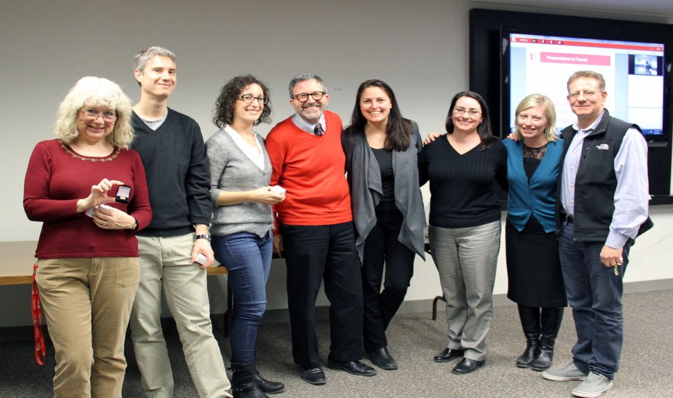
Faculty Awards
Dr. Joni Sasaki
John Templeton Foundation
Biological and cognitive approaches to explaining religious altruism: $108,846.68
Dr. Jennifer Steele
SSHRC- Insight Grant
The effect of contextual cues on children’s implicit racial attitudes: $35,838 (with co-investigator; Dr. Kerry Kawakami)
Dr. Jennifer Steeves
NSERC-Discovery Grant
The relationship between cortical object and scene areas in object and scene processing: $31,000
Dr. Dale Stevens
Canadian Foundation for Innovation/ Ontario Research Fund
Neurocognitive aging: Bridging the gap between neuroscience and neurointervention: $300,000 NSERC- Discovery Grant
Neural mechanisms underlying functional plasticity of the human brain: $24,000
Psychology Faculty receiving service pins. From left: Dr. Adrienne Perry, Dr. Dave Flora, Dr. Shayna Rosenbaum, Dr. Joel Goldberg, Dr. Jennifer Steele, Dr. Jennifer Steeves, Dr. Alexandra Rutherford, Dr. Joel Katz
28

Slide 33
Faculty Awards
Dr. Martin Steinbach
Glaucoma Research Society of Canada
Operating grant: Vection in patients with glaucoma: $20,000
Dr. C. Ward Struthers
SSHRC-Insight Grant
The effects of social power and apology on victims: Decisions to seek revenge against, harbour a grudge against, and forgive transgressors: $35,954
Dr. Christine Till
National Institute of Health (NIH)
Impact of early life fluoride exposure on cognitive and behavioural outcomes in children: $210,553 USD
Dr. Gary Turner
NSERC-Discovery Grant
Mapping neural mechanisms subserving executive control processes in younger and older adults: $29,000
Dr. Maggie Toplak
SSHRC-Insight Grant
The development of rational thinking abilities: Longitudinal change and real world outcomes: $94,102 (with co-investigators; Dr. Dave Flora)
What was your most exciting research finding or activity this past year?
We have recently found in our lab that top-down influences such as interpersonal similarity can influence face perception of out-groups. In particular, our research has demonstrated a linear effect in which Black targets that were ostensibly more similar to participants based on a personality test were subsequently better recognized than less similar targets. Participants also attended more to individuating features such as the eyes of these targets (Kawakami, Williams, et al., under review). Together these findings indicate that interpersonal similarity can reduce biases related to racial categorization processes.
- Dr. Kerry Kawakami
29

Slide 34
Faculty Awards
Dr. Jonathan Weiss
Chair: Autism Spectrum Disorders Treatment and Care Research, funded by CIHR in partnership with Autism Speaks Canada,The Sinneave Family Foundation, Spectrum of Hope Autism Foundation, and the Neurodevelopment Network: $140,000
Neurodevelopment Network
Mindfulness-based therapy for adolescents with autism spectrum disorders and their parents: $49,099 (with co-investigators)
Ministry of Community and Social Services
Changing support needs and service receipt in adults with Autism Spectrum Disorder in Ontario: Follow-up of two cohorts: $61,065 (with co-investigators)
CIHR/ Kids Brain Health Network
Cognitive behaviour therapy for mental health problems in children with neurodevelopmental disorders: A transdiagnostic Approach: $187,075 (with co-investigators; Dr. Yvonne Bohr, Dr. Maggie Toplak, Dr. Christine Till, Dr. Joylnn Pek)
30

Slide 35
Faculty Awards
Dr. Henny Westra
CIHR
Adding motivational interviewing to cognitive behavioural therapy for severe Generalized Anxiety Disorder: $54,717
Dr. Laurie Wilcox
NSERC-Discovery Grant
The role of stereopsis in the perception of objects: $40,000
NSERC
Assessment of image quality in high resolution display systems: $47, 760
NSERC/ Qualcomm Incorporated
Quality assessment in high resolution moving imagery: $39, 934
DRDC Research Collaboration
Operational requirements for binocular vision in aircrew: $60, 067
Dr. Georg Zoidl
Canada Research Chair (Tier 1) in Molecular Biology: $200,000
NSERC- Discovery Grant
Role of electrical synapses in vision: $31,000
Canadian Foundation for Innovation
Electrical synapses: From genes to functions using transgenic zebrafish: $28,763
Left: Zebra fish used in Dr. Zoidl’s research on electrical synapses.
31

Slide 36
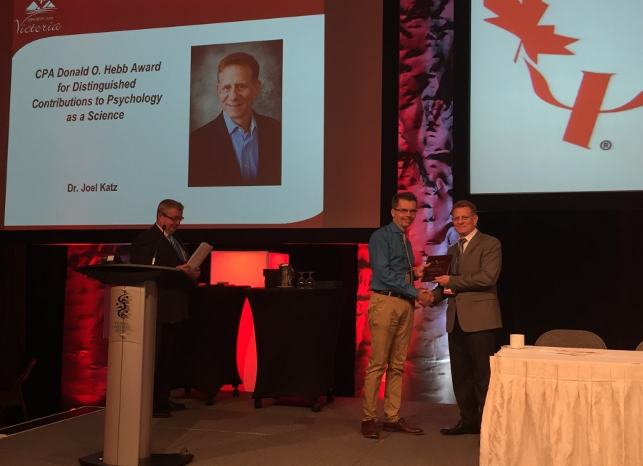
Faculty Awards
Honours & Distinctions
Dr. Marie Arsalidou
Recipient of the Hollingworth Award from the National Association for Gifted Children
Dr. Ellen Bialystok
Officer of the Order of Canada
Dr. Yvonne Bohr
Nominated for the Canadian Psychological Association Section of Women in Psychology Mentoring Award
Dr. Douglas Crawford
Sarrazin Award in Lectureship
Research Award- Faculty of Health
Dr. Mary Desrocher
Ontario Psychological Assocation Harvey Brooker Award for Excellence in Clinical Teaching
Below: Dr. Joel Katz receiving the Donald O. Hebb Award at the 2016 CPA convention in Victoria, BC.
Dr. Joel Katz
Canadian Psychological Association Donald O. Hebb Award for Distinguished Contributions to Psychology as a Science
Outstanding Pain Mentorship Award, Canadian Pain Society
Most Cited Paper Award, recognition of article by Pagé, Katz, et al. (Pain 2015: 156;460-68) as a 2015 “Top 25 Cited Article” in the Journal Pain
32

Slide 37
Faculty Awards
Dr. Louise Hartley
The President’s Leadership Award, York University
Dr. Michaela Hynie
President of the Canadian Association of Refugee and Forced Migration Studies (CARFMS)
Dr. Raymond Mar
The Tom Trabasso Young Investigator Award from the Society for Text & Discourse
Dr. Amy Muise
Canadian Psychological Association (CPA) President’s New Researcher Award
Dr. Jolynn Pek
Ontario Ministry of Research and Innovation’s Early Research Award
Dr. Debra Pepler
Queen’s University Doctorate of Science, Honoris Causa
UNICEF Innocenti Research Centre Senior Research Fellow
Dr. Rebecca Pillai Riddell
York University’s Presidential Emerging Research Leadership Award
York University Academic Innovation Fund
Dr. Shayna Rosenbaum
INS Award for Early Career Research, International Neuropsychological Society
York University’s Teaching Award-Established Career
Dr. Alexandra Rutherford
Association for Women in Psychology’s Florence Denmark Distinguished Mentoring Award
Dr. Thomas Teo
President, American Psychological Association, Division 24: Society for Theoretical and Philosophical Psychology
33

Slide 38
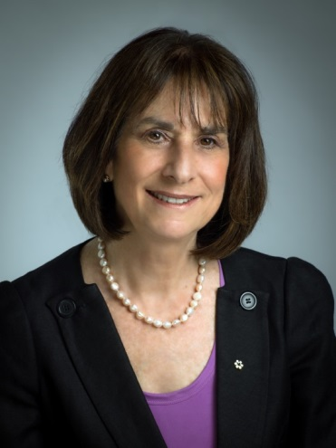
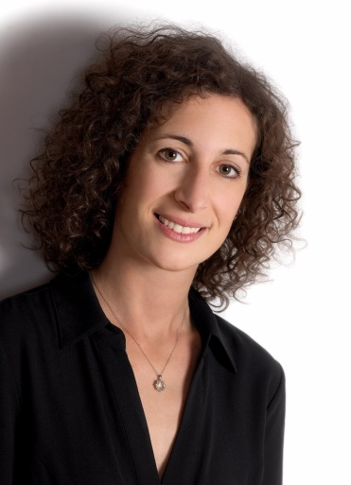
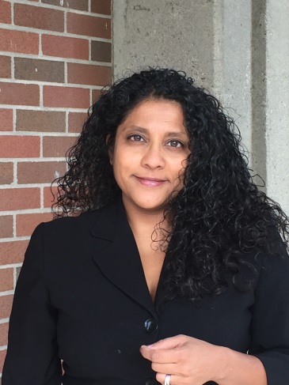
Faculty Awards
Current Canada Research Chairs
Dr. Doug Crawford
Canada Research Chair (Tier 1) in Visual-Motor Neuroscience (CIHR)
Dr. Gordon Flett
Canada Research Chair (Tier 1) in Personality & Health (SSHRC)
Dr. Joel Katz
Canada Research Chair (Tier 1) in Health Psychology (CIHR)
Dr. Georg Zoidi
Canada Research Chair (Tier 1) in Molecular and Cellular Neuroscience (CIHR)
Current York Research Chairs
Dr. Ellen Bialystok* NEW
Walter Gordon York Research Chair (Tier 1) in Lifespan Cognitive Development
Dr. Shayna Rosenbaum* NEW
York Research Chair (Tier 2) in Cognitive Neuroscience of Memory
Dr. Rebecca Pillai Riddell
York Research Chair (Tier 2) in Pain and Mental Health
Dr. Bialystok
Dr. Rosenbaum
Dr. Pillai Riddell
34

Slide 39
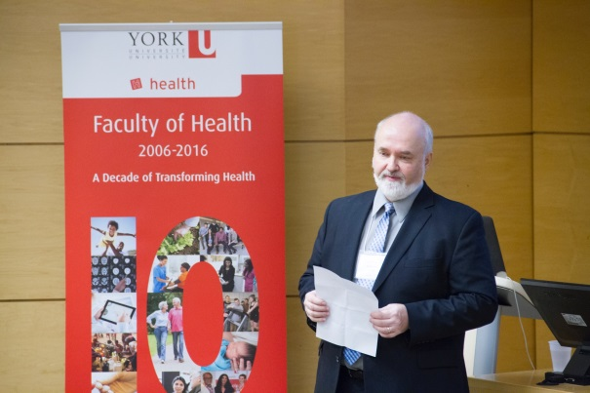
Organized Research Units
Institute for Social Research (ISR)
Contains the largest university-based survey research centre in Canada.
Offers expert consulting in statistics for York faculty, graduate students and community members.
Provides a range of “short courses” in statistical programs and analysis such as:
Introduction to Structural Equation Modeling (Dr. Robert Cribbie)
Practical Power Analysis (Dr. Jolynn Pek)
Using R for Graphics (Dr. Michael Friendly)
Modeling and Analysis of Longitudinal and Nested Data (Dr. Georges Monette)
Selected projects
Health Care Experience Survey (2012-present
Rapid Risk Factor Surveillance Survey (2001-present)
Medical Marijuana Use in Ontario Study (2015)
Website: www.yorku.ca/isr
LaMarsh Centre for Child and Youth Research
Develops community-engaged interdisciplinary research in education, health, relationships and the development of infants, children, adolescents, emerging adults and families
This year’s annual Dr. Eric Jackman lecture was held on April 28, 2016 featuring guest speaker Dr. Marc Bornstein, president-elect of the Society for Research in Child Development, and founding editor of Parenting: Science and Practice. His talk was entitled, “Developing Children in the Developing World”
Website: www.yorku.ca/lamarsh
Left: Director of the LaMarsh Centre for Child and Youth Research, Dr. Gordon Flett, at the annual Dr. Eric Jackman Lecture (April 2016)
35

Slide 40
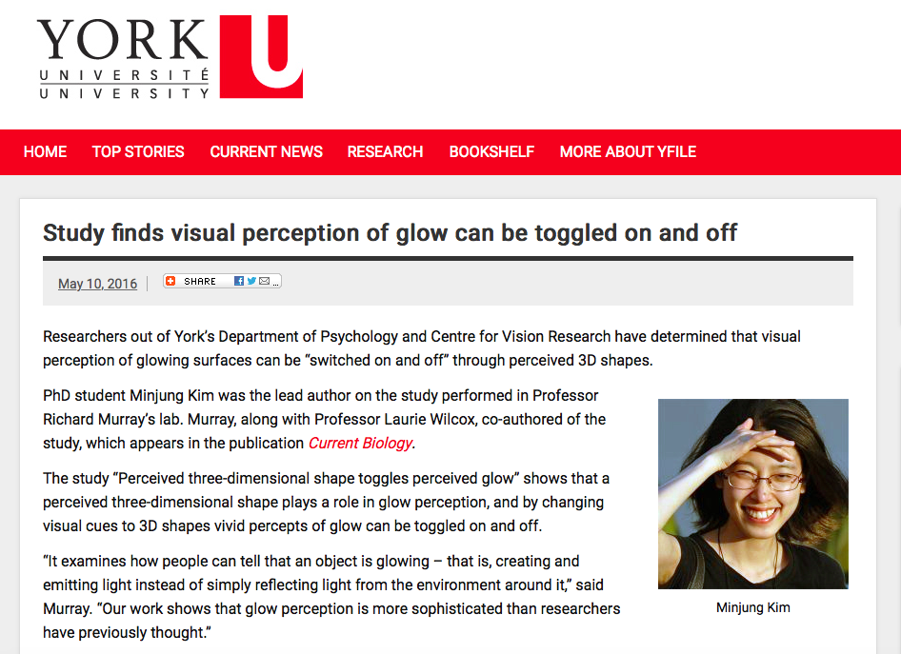
Organized Research Units
York Centre for Vision Research
International leader in human and machine vision research.
In 2016 received a grant of $33.3 Million for new 'Vision: Science to Applications' (VISTA) program
Cutting-edge resources include a 3T fMRI scanner, a six-sided immersive virtual reality room, and a Christie Edgeless Graphics Geometry 3D
Hosts three NSERC-funded CREATE Training Programs
Offers a week-long, all-expenses-paid undergraduate summer school focusing on vision science.
Selected recent research projects:
Continuous updating of visuospatial memory in superior colliculus during slow eye movements (Dr. Doug Crawford; published in Current Biology)
Website: www.cvr.yorku.ca
Above: A screenshot from a 2016 yFile article featuring glow surface research conducted in Dr. Richard Murray’s Lab.
36

Slide 41
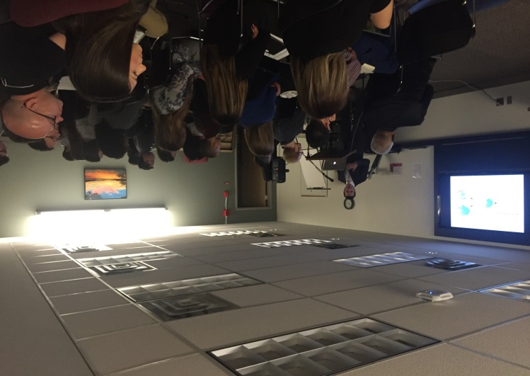
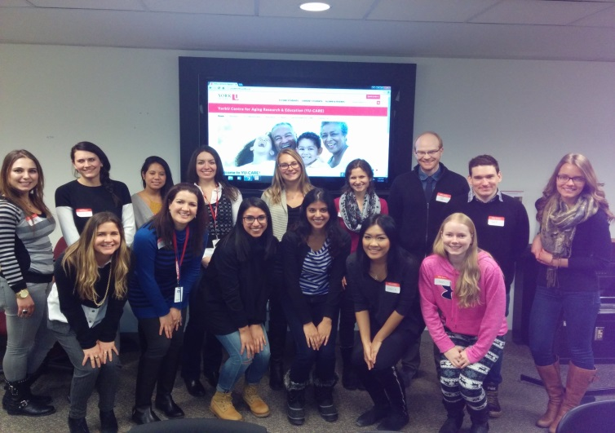
Organized Research Units
York Institute for Health Research
Produces interdisciplinary, multi-method, community-engaged and policy-relevant health research, locally, nationally and internationally.
Selected research projects:
Taking Action! Art and Aboriginal youth leadership for HIV prevention
Disability, rights monitoring, and social change
Community mental health interventions for maternal mental health in Rwanda
Modeling antimicrobial disease resistance for public health planning
Website: www.yorku.ca/yihr
YU-CARE (York University Centre for Aging Research and Education)
Investigates how to optimize functioning in age
The Trainee Association of the York University Centre for Aging Research and Education (YUCARE), organized a research symposium focusing on ‘Multi-Dimensional Perspectives on Aging’. The full day event, hosted in the Department of Psychology, featured two Keynote addresses from experts in aging research from York (Dr. Mary Fox) and Cornell University (Dr. Nathan Spreng). The event also included trainee presentations and poster sessions.
Website: www. yucare.info.yorku.ca
Above: Keynote speaker, Dr. Nathan Spreng, at the 2016 YU-CARE Research Symposium
Above: A photo of the YU-CARE Trainee Network at the Meet and Greet Event (March 2016).
37

Slide 42
Our Research in the Media
Profiling Psychology Faculty and Students from Various Media Sources
The Chronicle of Higher Education
“The Flaw at the Heart of Psychological Research”
Researcher: Dr. Christopher Green
BBC World Service-The Forum
“The Benefits of Bilingualism”
Researcher: Dr. Ellen Bialystok
BBC World Service-The Forum
“The Pleasures and Perils of Storytelling
Researcher: Dr. Raymond Mar
The Toronto Star
“C-section babies slower to focus their attention, says study” (2015)
Researcher: Dr. Scott Adler
yFile
“CIHR grants $2.16M to fund two York research projects”
Researchers: Drs. Jonathan Weiss and Michaela Hynie
The Scientific Parent
“Parents have extraordinary power to calm kids in pain”
Researcher: Dr. Rebecca Pillai Riddell
38

Slide 43
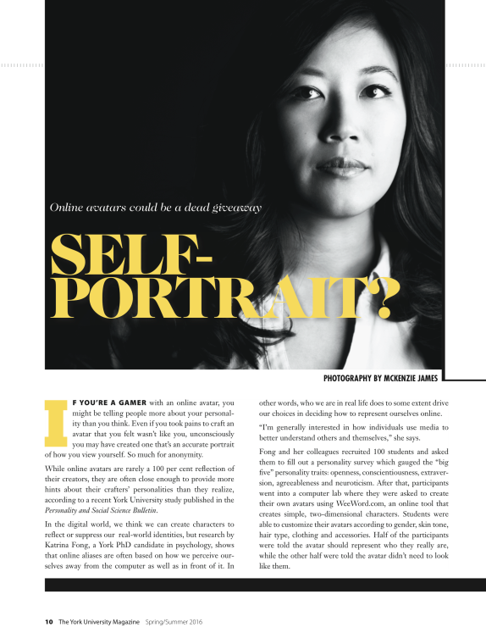
Our Research in the Media
Profiling Psychology Faculty and Students from Various Media Sources
National Public Radio (NPR)
(Also featured in The Globe & Mail, Daily Mail & Radio Canada)
“Parents Can Help Reduce Pain And Anxiety From Vaccinations”
Researchers: Dr. Rebecca Pillai Riddell & Nicole Racine
CBS News
“Helping ‘Satellite Babies’ Thrive in the U.S.”
Researcher: Dr. Yvonne Bohr
The Wall Street Journal
“Women are more interested in sex than you think, studies show ”
Researcher: Dr. Amy Muise
York U Magazine
“Online Avatars Could be a Dead Giveaway: Self Portrait?”
Researcher: Katrina Fong & Dr. Raymond Mar
CBC Radio
“Loneliness, stigma, and the elderly”
Researcher: Dr Ami Rokach
39

Slide 44
Our Research in the Media
Profiling Psychology Faculty and Students from Various Media Sources
The Toronto Star
“No quick fix to society’s opioid crisis ”
Researcher: Dr. Joel Katz
The Guardian
“Why being bilingual works wonders for your brain ”
Researcher: Dr. Ellen Bialystok
yFile
“York U lab gives high school co-op students research experience”
Researcher: Dr. Shayna Rosenbaum
CBC National News
“Dancing with Parkinson’s”
Researcher: Dr. Joseph DeSouza
National Geographic
“How wild animals are hacking life in the city”
Researcher: Dr. Suzanne MacDonald
Nature
“Move over, morphine”
Researcher: Dr. Joel Katz
CNN Health
“Helping patients with autism navigate the stressful ER ”
Researcher: Dr. Jonathan Weiss
y-File
“Open your Mind: A Q&A with Psychology Researcher Karen Fergus”
Researcher: Dr. Karen Fergus
40

Slide 45
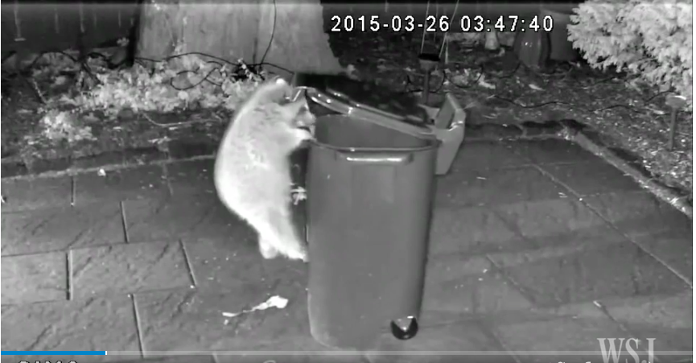
Our Research in the Media
Our Research in the Media
Profiling Psychology Faculty and Students from Various Media Sources
Profiling Psychology Faculty and Students from Various Media Sources
The National Post
“The key to a better love life is sex — but only once per week”
Researcher: Dr. Amy Muise
yFile
“Researcher shows how brain differentiates similar memories”
Researcher: Dr. Shayna Rosenbaum
The Wall Street Journal
“Toronto vows to outsmart its raccoons”
Researcher: Dr. Suzanne MacDonald
Below: Snapshot from The Wall Street Journal media article
41

Slide 46
Research in the Community
Dr. Shayna Rosenbaum
Ontario Centres of Excellence (OCE)-sponsored industry partnership with Axonify to implement best learning practices in the workplace: http://www.axonify.com/
Dr. Rosenbaum hosted grade 11 students from Richmond Hill High School to complete co-op placement in her lab.
Dr. Rob Muller
Dr. Muller is the current director of the Trauma Practice for Building Healthy Communities, a nonprofit and charitable organization to promote psychological health following trauma. Also editor of The Trauma & Mental Health Report.
Dr. Jonathan Weiss
We hosted the TEDxYorkUSalon Event: Spectrum, with talks by 10 stakeholders focused on the experience of Canadians with Autism Spectrum Conditions: http://www.tedxyorkusalon.org
Dr. Debra Pepler
Dr. Pepler is involved with Breaking the Cycle, a program for substance using mothers and their children, since its inception over 20 years ago. This year, they were awarded a five-year grant from the Public Health Agency of Canada to disseminate a healthy relationships intervention to 30 sites in Canada in an effort to prevent domestic violence and child maltreatment.
Dr. Christopher Green
Shane Martin (a York graduate) and I developed an online game by which we crowd-sourced answers to the question, “Who has had the greatest impact on psychology?” http://elo.sha.nemart.in . The "Top 5,” based on over 90,000 ratings, were Wundt, Skinner, Freud, Piaget, Pavlov.
42

Slide 47
Research in the Community
Dr. Thomas Teo
Dr. Alexandra Rutherford and Dr. Teo at York University in collaboration with colleagues from around the country are establishing a network and online portal highlighting critical psychologists in Canada (provisional title: Critical Psychology Network - Canada). The aim is to facilitate students’ efforts to find graduate training opportunities in critical psychology (e.g., doctoral supervisors, external examiners, postdoc placements, etc.).
Dr. Jolynn Pek
The Statistical Consulting Service has developed a Wiki to document book discussions, as well as neat methodological developments.
http://scs.math.yorku.ca/index.php/Wiki_for_statistical_consulting
Dr. Amy Muise
Dr. Muise writes for a website that shares relationship research with the general public:
http://www.scienceofrelationships.com/home/category/sex-musings
Dr. Alexandra Rutherford
Dr. Rutherford is currently working with a team in the APA Women's Programs Office and the Cummings Center for the History of Psychology to develop psychology curriculum materials for high school students that are more inclusive of the contributions of women and esp. women of color.
43

Slide 48
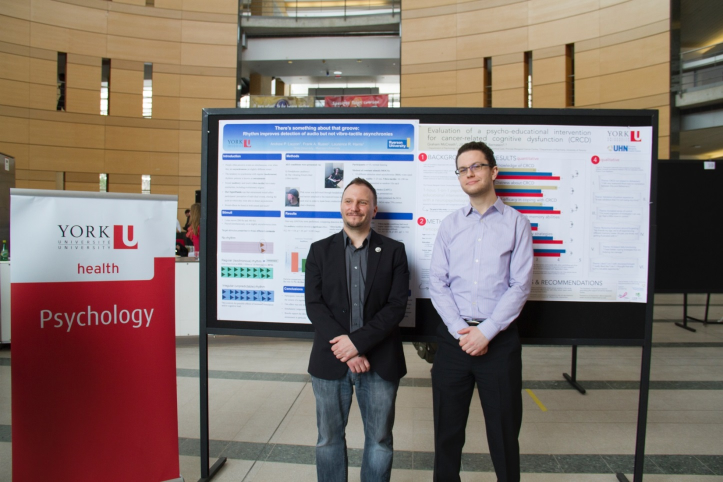
Emerging Researchers
Undergraduate Students
2016 DEPARTMENT OF PSYCHOLOGY POSTER DAY WINNERS
Left: Andrew Lauzon “There's something about that Groove: Rhythm Improves Detection of Audio but not Vibro-tactile Asynchronies, supervised by Dr. Laurence Harris.
Right: Graham McCreath, Evaluation of a Psychoeducational Intervention for Cancer Survivors Experiencing Cognitive Difficulties, supervised by
Dr. Jill Rich
44

Slide 49
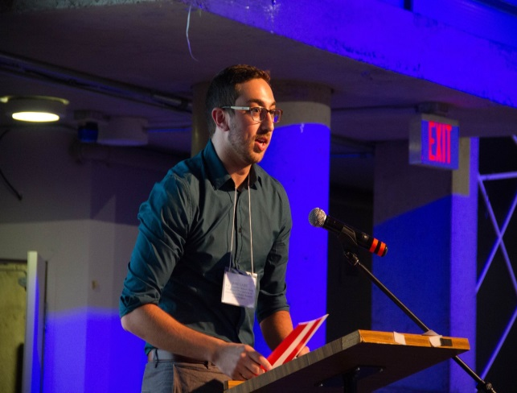
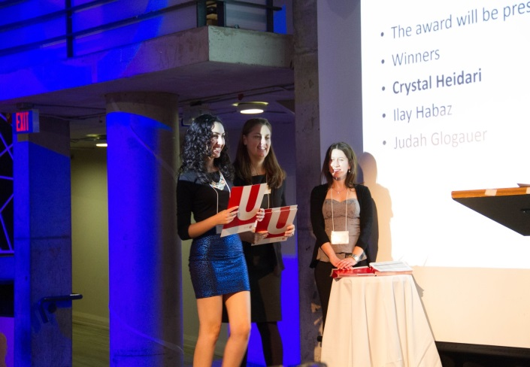
Emerging Researchers
Undergraduate Students
Award | The W.B. Templeton Honours Thesis Award | Originality Prize in Memory of Paul Jeffrey Kusyszyn | The Sandra Pyke Scholarship Award
Recipients: | Rebecca Abavi Jamie Cazes | Zita Lau | Crystal Heidari Ilay Habaz Judah Glogauer
Award Description: | Awarded to the most outstanding 4th year Honours theses | Awarded to the 4th year Honours student with the most original BA Honours Thesis with a minimum grade of A | Awarded to the student with the highest GPA at end of third year, as well as an A+ in Psychology of Women
Above Left: Jaime Cazes receiving the Templeton Honours Thesis Award. Supervisor: Dr. Shayna Rosenbaum
Below Left : Crystal Heidari receiving the Sandra Pyke Scholarship
45

Slide 50
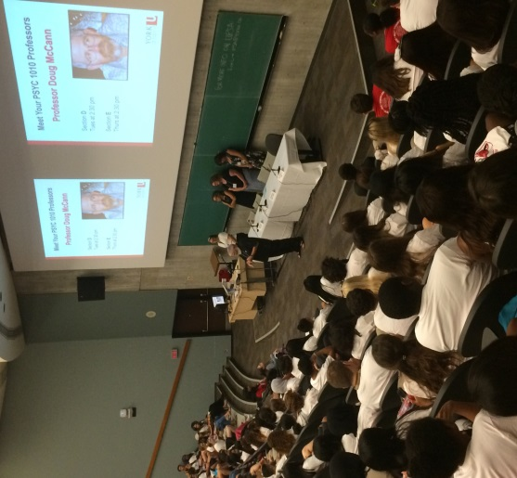
Emerging Researchers
Undergraduate Students
Award | Ivana Guglietti-Kelly Prize | The W.B. Goranson Memorial Research Award
Recipients: | Raffi Aintablian | Khushbu Patel Helena Brown Faraz Honarparvar
Award Description: | Awarded to an undergraduate student using qualitative methods illuminating psychological processes | Awarded to 4th year Honours students to be used for thesis research
Psychology Undergraduate Book Prizes
Awarded to full-time Psychology majors with the highest sessional GPA in their year
2nd year students
Marette Abdelmaseh
Chanhee Seo
3rd year students
Stefano Costa
Noah Gasner
Andrei Nistor
4th year students
Nataly Beribisky
Ariel Landa
Right: Dr. Doug McCann at the Department of Psychology Orientation for Undergraduate Students
46

Slide 51
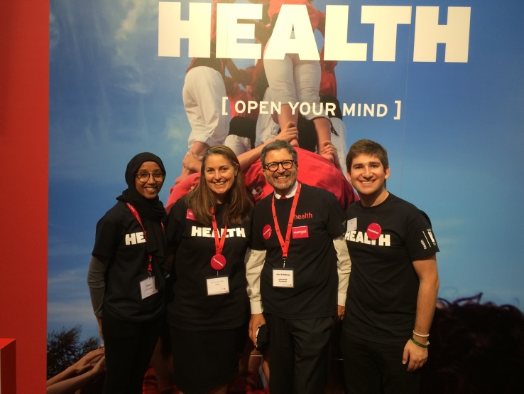
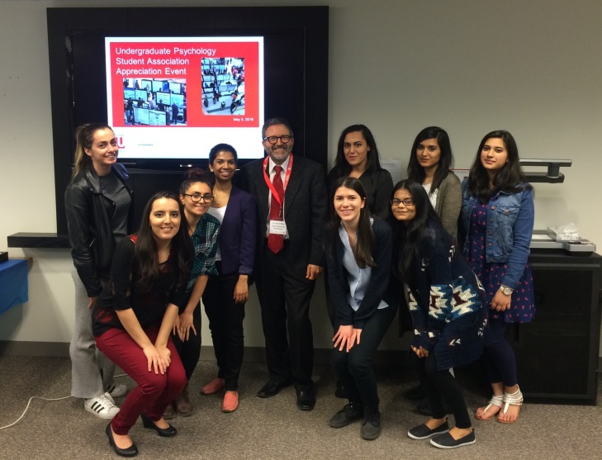
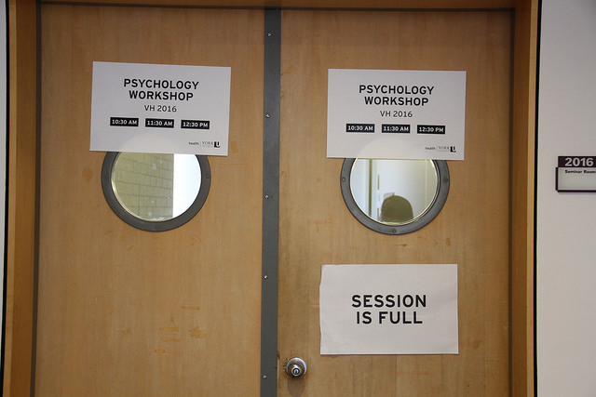
Emerging Researchers
Undergraduate Students
Above: Drs. Jennifer Steele and Joel Goldberg (centre) with Psychology undergraduate health ambassadors at the Ontario Universities Fair (September 2016)
Above: 2016 Undergraduate Psychology Student Association (UPSA)
Fall Campus Day (November 2016)
47

Slide 52
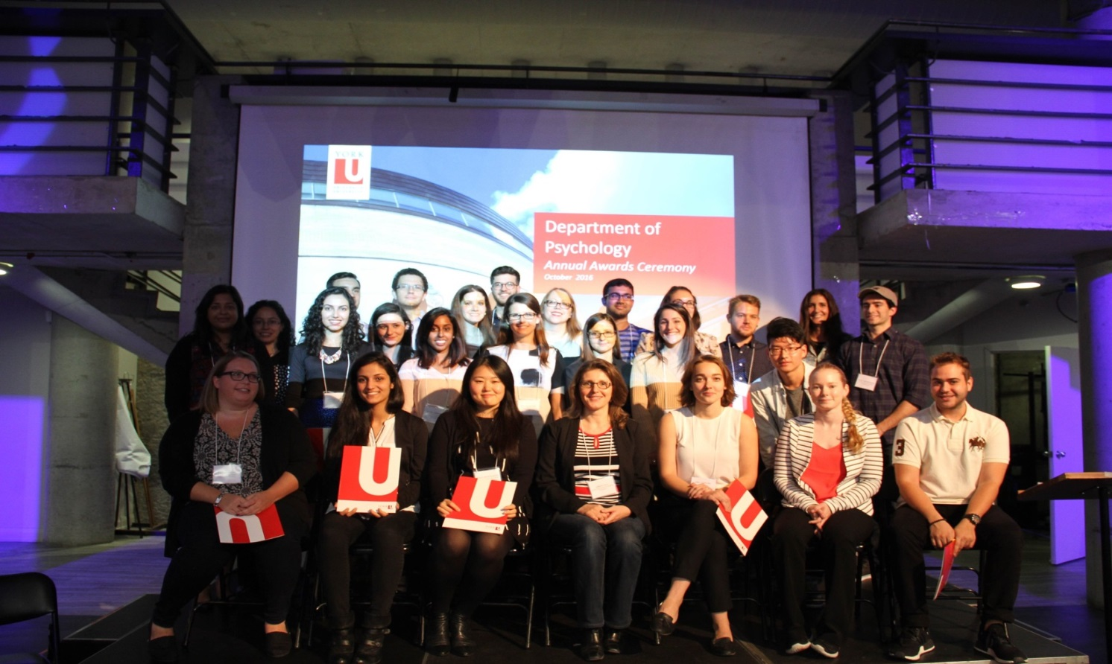
Emerging Researchers
Graduate Students & Post-Doctoral Fellows
2015-2016 Major Award Tallies
• Ontario Graduate Scholarship: 18 at the MA level; 23 at the PhD level
• Queen Elizabeth II Graduate Scholarship in Science and Technology: 1
• Canadian Institutes of Health Research (CIHR): 2 at the MA level: 6 at the PhD level
• Natural Sciences and Engineering Research Council of Canada (NSERC): 1 at
the MA level; 3 at the PhD level
• Social Sciences and Humanities Research Council of Canada (SSHRC): 9 at
the MA level, 7 at the PhD level
• Susan Mann Dissertation Scholarship: 1
Below: a photo of the Undergraduate and Graduate award winners at the Department of Psychology 2016 Awards Ceremony
48

Slide 53
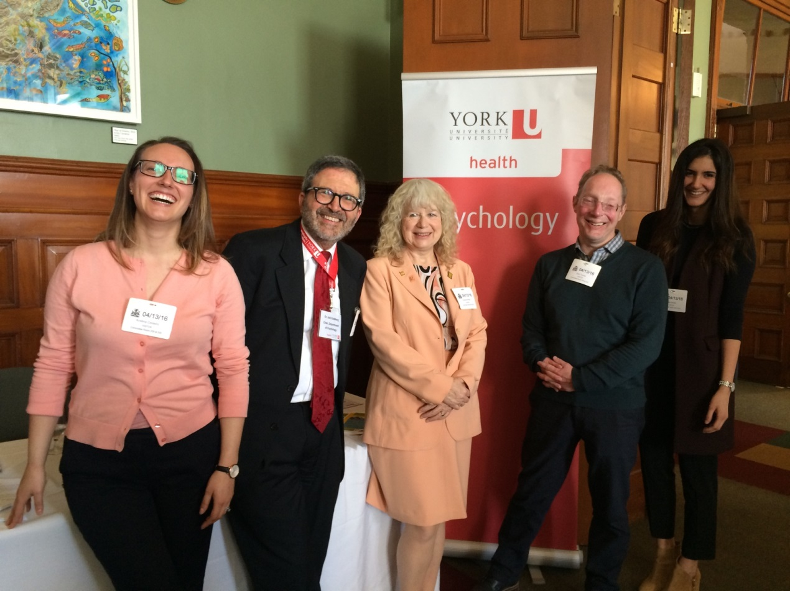
Emerging Researchers
Graduate Students & Post-Doctoral Fellows
Sara Rafique & Lindsay Fraser received E. Lynn Kirshner Memorial Scholarships for excellence in Visual Science Resarch
Khush-Bakht (KB) Zaidi received The Monica Reena Goyal Memorial Bursary
Jorida Cila received The Sandra Pyke Award for Graduate Student Excellence
Jenny Rabin, a recent graduate of Dr. Shayna Rosenbaum, received the Governor General Gold Medal. She currently holds a CIHR Banting postdoctoral fellowship at the MGH Martinos Center for Biomedical Imaging, affiliated with Harvard University.
Steven Baker is the first author on a paper published in Current Biology (impact factor=9.571)
Elissa Rodkey received a Certificate of Academic Excellence (Doctoral) from the Canadian Psychological Association
Above (from left to right): *Kristina Cordeiro, Dr. Joel Goldberg, Dr. Adrienne Perry, Dr. Gary Turner and *Jala Rizeq at Queen’s Park representing York University, meeting with Members of Parliament concerning mental health issues (February 2016).
49

Slide 54
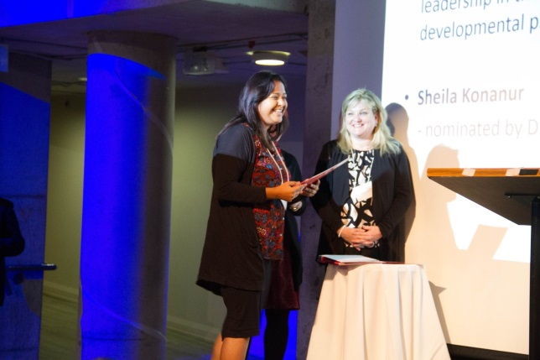
Emerging Researchers
Graduate Students & Post-Doctoral Fellows
Iana Ianakieva received the The Ivana Guglietti-Kelly Prize for Qualitative Research
Komal Shaikh (Doctoral) & Shira Yufe (Master’s) received Ontario Women’s Health Scholars Awards
Kaley Roosen & Melissa Button received Student Excellence Awards in Clinical Psychology
Naomi Carpenter received the Award for Excellence in Psychotherapy Process Research
Sarah D’Amour received a Council of Canadian Departments of Psychology Teaching Assistantship Award
Katrina Fong appeared in YorkU Magazine profiling her research with online avatars.
Above: *Sheila Konanur & Lori Santos
Sheila Konanur received the Leadership Award, Clinical-Developmental in Psychology
Ksusha Blacklock received the Research Award in Clinical-Developmental Psychology
Jessica Jeong received the YUPC Award in Clinical-Developmental Psychology
Sarah Ritvo received a Council of Canadian Departments of Psychology Teaching Assistantship Award
Brittany Rosenbloom received a CIHR Doctoral Research Award in honour of Nelson Mandela
Vered Vlatman received a QE II Graduate Scholarship in Science and Technology for her project titled: Attention Training for Pain.
Jordana Waxman received a Certificate of Academic Excellence (Master’s) from the Canadian Psychological Association
Joo Ann Lee received a Council of Canadian Departments of Psychology Teaching Assistantship Award
Joo Ann Lee received The Michael Friendly Award for Quantitative Methodology Research
Mariela Giuliano received a Council of Canadian Departments of Psychology Teaching Assistantship Award
Student Highlight: *Melissa Button (as told by her supervisor Henny Westra)
Melissa Button, one of the graduate students in the Westra lab, received both the Dissertation Award from the Society for the Exploration of Psychotherapy Integration (SEPI) and the Student Excellence Award from the Clinical Area. She is not only an outstanding clinical scientist but also an excellent citizen in the clinical area.
50

Slide 55
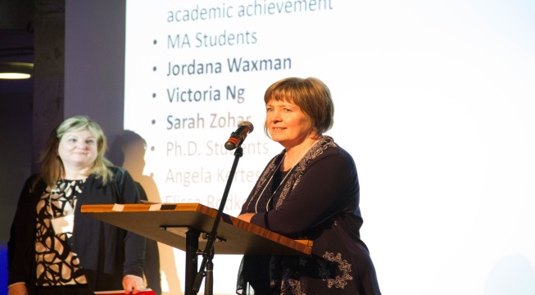
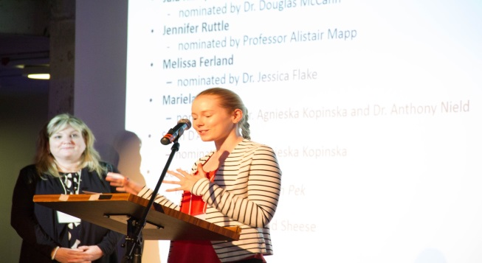
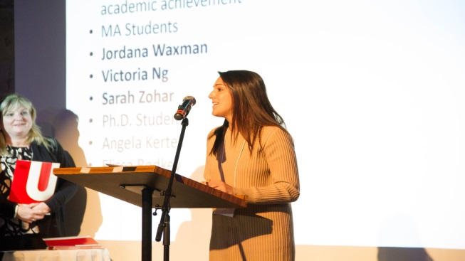
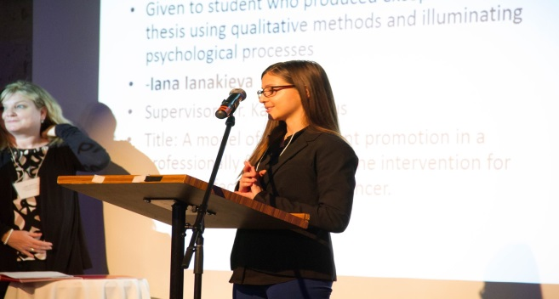
Emerging Researchers
Graduate Students & Post-Doctoral Fellows
Victoria Ng received a Certificate of Academic Excellence (Master’s) from the Canadian Psychological Association
Alex Porthukaran received a Monica Reena Goyal Memorial Bursary
Angela Kertes received a Certificate of Academic Excellence (Doctoral) from the Canadian Psychological Association
Stefania Moro was awarded a Susan Mann Dissertation Scholarship
Sarah Zohar received a Certificate of Academic Excellence (Master’s) from the Canadian Psychological Association
Melissa Ferland received a Council of Canadian Departments of Psychology Teaching Assistantship Award
Jala Rizeq received a Council of Canadian Departments of Psychology Teaching Assistantship Award
Mahta Kakvan & Busisiwe Ncube were awarded Graham Reed Memorial Bursaries
Ashley Malin received The Norman Endler Research Fellowship in Psychology
Busisiwe Ncube was awarded the The Gales Graduate Scholarship For Behaviour Analysis
Emily Barlow-Krelina won the Graduate Student MA Award in Clinical-Developmental Psychology
Diane Lawless received a Certificate of Academic Excellence from the Canadian Psychological Association
Jennifer Ruttle received a Council of Canadian Departments of Psychology Teaching Assistantship Award
Top to Bottom: *Dr. Diane Lawless, *Jennifer Ruttle, *Jordana Waxman and *Iana Ianakieva at the Psychology Awards Ceremony.
51

Slide 56
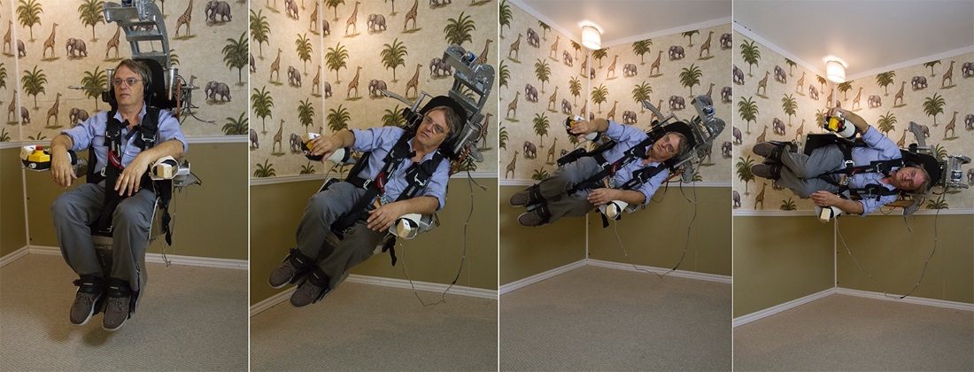
Experiential Learning
As part of my Sensation and Perception course I give students visual phenomena that they can all see. For example, I bring in lights that I hold in my hands to illustrate apparent motion and give the whole class after effects and after images. Each student gets to experience the huge blind holes in their visual fields that they have been carrying around unknowingly since they were born!
Dr. Laurence Harris
Below: Dr. Laurence Harris being rotated in the new Tumbling Room Facility (made possible by funding from the Canadian Foundation for Innovation, CFI). The equipment allows us to look at the role of gravity and motion in perception.
Clinical students in my graduate class conduct a psychoeducational assessment of a child in the YUPC. Students learn about assessment in real time and in the real world.
- Dr. Christine Till
We have added direct clinical training to our program with the addition of the York University Psychology Clinic, and we have really refined our training model to nicely fit with the needs of our trainees. Specifically, we provide training at the very beginning and final stages of the program to support students in entering this field of work (at the beginning) and supporting them to help complete their programs (at the end). It has been very satisfying as a YUPC clinical supervisor to see our students thrive in this model that we have developed in our program.
- Dr. Maggie Toplak
52

Slide 57
Experiential Learning
Last year students worked on completing research theses in collaboration with several community partners. And as always, the students did amazing projects, including working with Taking IT Global to conduct on-line focus groups with youth in Nunavut about engaging in art activities as a way of building a sense of community and belonging, a project with Southlake where they documented the impact of uninterrupted mealtimes on food intake and nutrition among inpatients, and the effectiveness of mentoring for youth in a national YMCA youth mentorship program.
- Dr. Michaela Hynie
I have been using TopHat—a classroom engagement system—and it has helped participation and active learning in my Social Psychology class with nearly 200 students. I have used the system to engage students in classroom activities, to allow students to share their thoughts and to quiz students on the course material. Based on the informal feedback I have received the students feel it has increased their engagement and enhanced their recall of course material.
- Dr. Amy Muise
I had a wonderful guest lecturer come to my Abnormal Psychology Class to speak about Aboriginal and indigenous mental health. Tera Beaulieu, York undergrad alum and my former thesis student, a member and leader of the Metis Nation and a Vanier Scholar, was recently appointed to the Mental Health Commission of Canada and gave a FANTASTIC and eye-opening talk about indigenous frameworks of mental health and wellness.
Dr. Alexandra Rutherford
I was part of a team from York University, Carleton University and the University of Windsor who put together an online course in Structural Equation Modeling. The course was taught for the first time in the winter of 2016.
-Dr. Rob Cribbie
I've made use of Camtasia to record laboratory sessions on SAS for statistics courses (e.g., PSYC 6160: Hierarchical Linear Modeling).
-Dr. Jolynn Pek
53

Slide 58
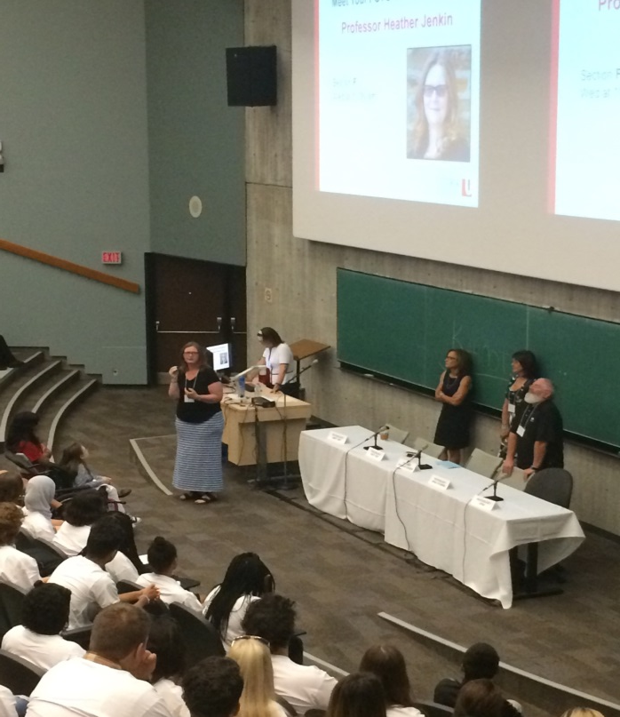
Contract Faculty Contributions
Dr. Shari Geller
Geller, S. (2017). A practical guide for cultivating therapeutic presence. American Psychological Association
Dr. Ami Rokach
Rokach, A. (2016a). Psychological, emotional and physical experiences of hospitalized children. Clinical Case Reports and Reviews, 2(4), 399-401.
Rokach, A. & Philibert, G. (2016b). Bullying and victimization in jail. Psychology and Education, 53 (1 & 2), 99-111.
Rokach, A. (2016c). Preface to special issue on Bullying. Psychology and Education, 53 (1 & 2).
Rokach, A. (Ed.) (2016). Correlates of loneliness. An eBook by Bentham, Science Pub., U.A.E.
Above: Dr. Heather Jenkin speaking to first year students at the Undergraduate Psychology Orientation (Sept.2016)
54

Slide 59
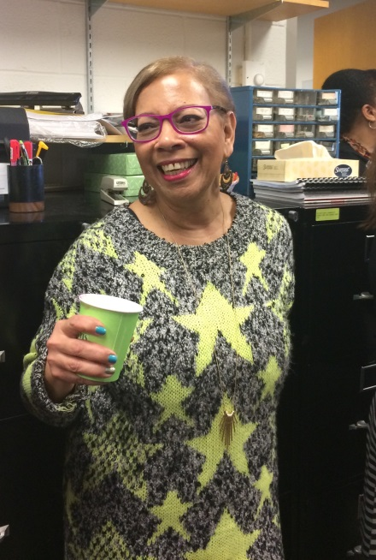
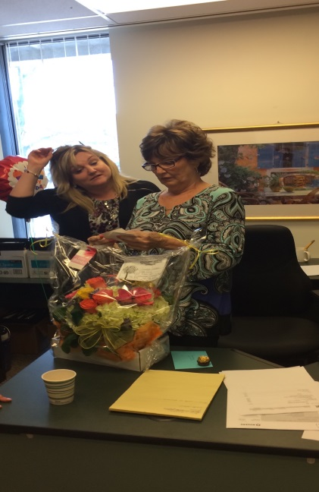
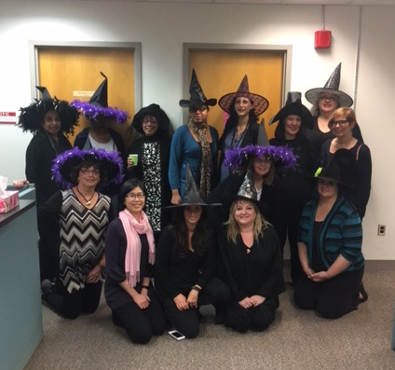
Psychology Staff
In appreciation of our long-service Psychology staff, for all of your many contributions over decades of challenges and success.
Ann Pestano-Administrative Assistant to the Chair
Lori Santos presenting Sandra Locke with a retirement gift
The Psychology Staff in holiday costume (October 31, 2016)
55

Slide 60
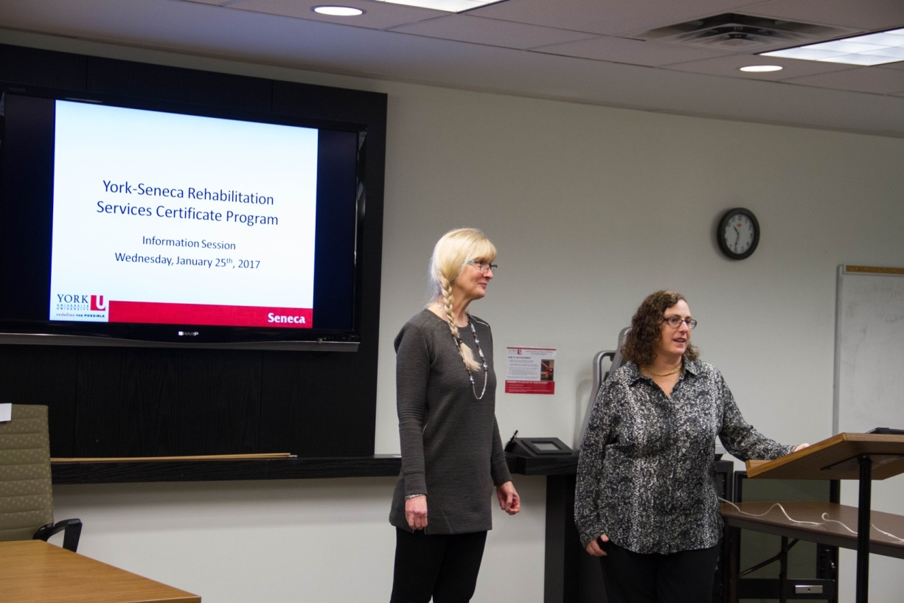
Partnering with Seneca College
Above from left: Barb Pimenoff and Dr. Jill Rich, RSCP Coordinators
Established in 1981, the York-Seneca Rehabilitation Services Certificate Program (RSCP) is the only program of its kind in Canada.
What is unique is that upon completion of program, students receive both a B.A./B.Sc. or B.A./B.Sc. (Honours) degree with a Psychology focus from York University, as well as a Certificate in Rehabilitation Services from Seneca College. The program requires four (B.A./B.Sc.) or five (B.A./B.Sc. Honours) years of study.
What is also most amazing are the practical experiences -
in addition to our York and Seneca classroom courses, students complete 800 hours of fieldwork at rehab placements such as: Surrey Place, WSIB and the Insurance Services Sector
56

Slide 61
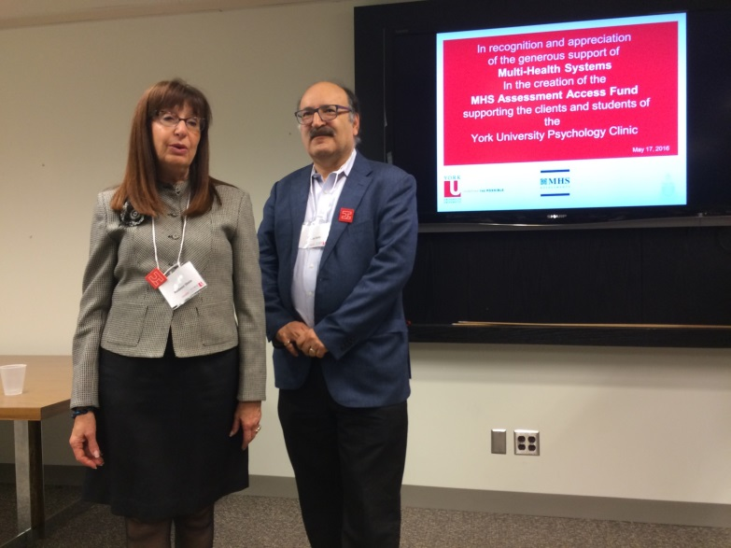
York University Psychology Clinic
Now in our eighth year, the clinic continues to develop and thrive. A major highlight of the year was the establishment of the MHS Assessment Access Fund that has enabled us through graduate student training experiences to offer assessments to children/youth whose families are in financial need. Removing the financial barrier that exists for many individuals has helped 13 families access assessments for their children which in turn will help them get services to be more successful in their education.
Our first pre-doctoral intern completed her Toronto Consortium Internship and found the clinic to be a good training centre in terms of providing her with a diverse range of clients (age, cultural backgrounds) and types of problems. She felt well supported in the development of her skills in Emotion-Focused Therapy through the supervision of Dr. Sandra Paivio, a new addition to our clinical supervisory team. We had 4 senior students complete an optional third practicum in the clinic that focused on both assessment and intervention training.
We were able to run three groups: Cognitive Behavior Therapy for Anxiety and Worry, Acceptance and Commitment Therapy for Emotion Regulation and a Memory and Aging Program. These groups provide senior doctoral level candidates with an opportunity to lead/co-lead the group and offer our junior students the ability to observe the groups and be part of post group supervisory discussions.
Left: Dr. Steven Stein and Rodeen Stein, Multi-Health Systems, establish the MHS Assessment Access Fund – to support children/youth.
57

Slide 62
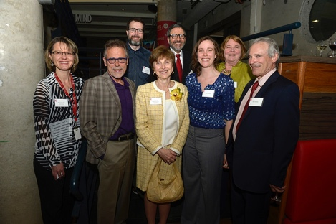
YUPC
Our Continuing Education programs continue to operate at full capacity. In addition to our Emotion-Focused Therapy training, this past year we offered a workshop on Using Motivational Interviewing to acquire the critical skill of Rolling with Resistance led by Dr. Henny Westra.
On a personal note, another highlight for me was being awarded the President’s Leadership Award. This occurred because of the efforts of a broader team of colleagues and faculty members whose support of the clinic and me has been instrumental in our success.
-Dr. Louise Hartley, YUPC Director
Above from Left: Dr. Louise Hartley (centre) after receiving the 2016 President’s Leadership Award. From left: Maggie Toplak, Harvey Skinner, John Eastwood, Louise Hartley, Joel Goldberg, Laura Hartley, Suzanne Killick and John Hartley.
58
Notes:
P

Slide 63
Editorial Team
Dr. Joel Goldberg, Editor
Chair of the Department of Psychology
Shira Yufe, Editor
Graduate Student, Department of Psychology
Contact Us
The Department of Psychology, Faculty of Health, York University Behavioural Science Building, Room 101
4700 Keele Street
Toronto, ON M3J 1P3
Website: http://psyc.info.yorku.ca/
Undergraduate Psychology Office Behavioural Science Building, Room 291/292
Telephone: 416 736 5117 | Email: psyc@yorku.ca
Website: http://psyc.info.yorku.ca/
Graduate Psychology Office
Behavioural Science Building, Room 297
Telephone: 416 736 5290 | Email: gradpsyc@yorku.ca
Website: http://psychology.gradstudies.yorku.ca/
Graduate Admissions Telephone: 416 736 5000
Website: http://futurestudents.yorku.ca/graduate
59

